Slide 1

Streamflow and Groundwater Conditions in Rhode Island
October 8, 2020
C. Bruet
U.S. Geological Survey
New England Water Science Center

Slide 2
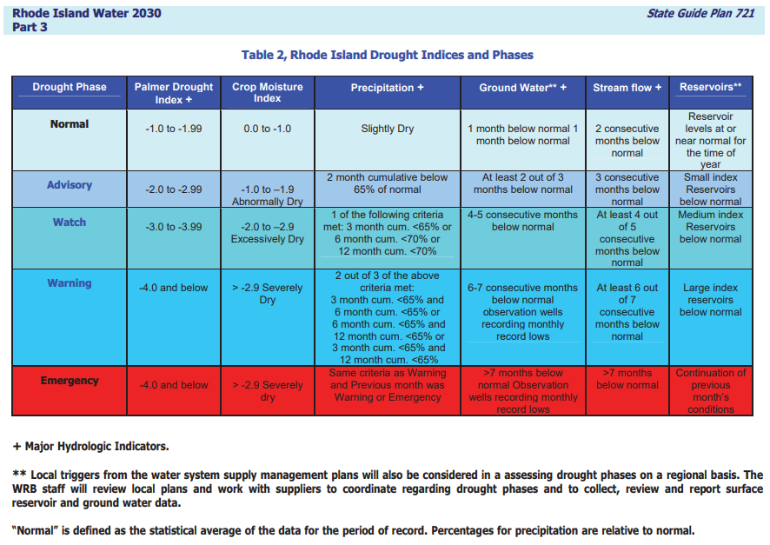


Slide 3
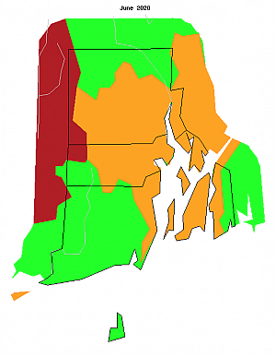
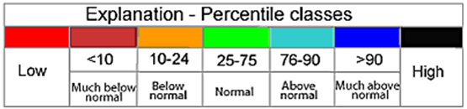
Average Streamflow Conditions – June 2020
Notes:
Normal

Slide 4
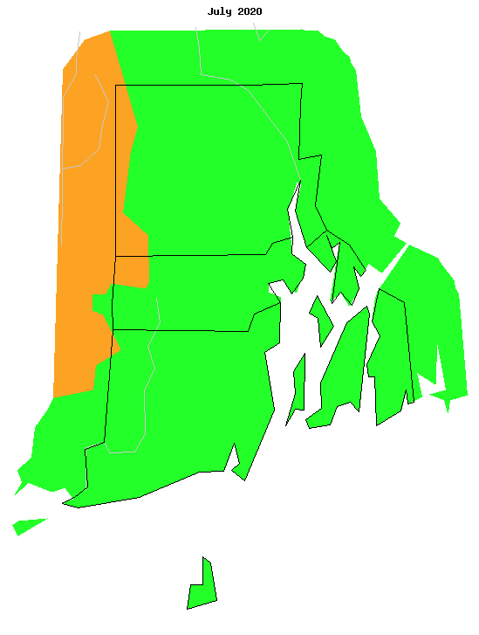
Average Streamflow Conditions – July 2020
Notes:
Normal

Slide 5
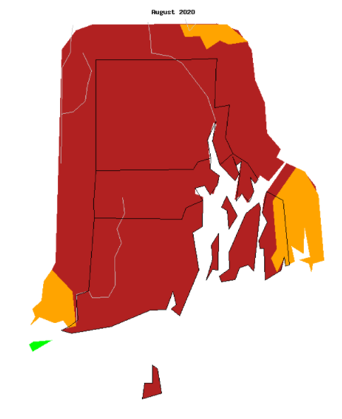
Average Streamflow Conditions – Aug. 2020
Notes:
Much Below Normal
Multiple Monthly mins

Slide 6
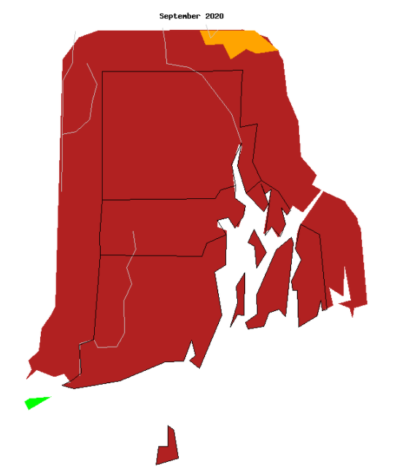
Average Streamflow Conditions – Sept. 2020
Period of Record instantaneous low flows at 6 sites
NOOSENECK RIVER AT NOOSENECK, RI
QUEEN R AT LIBERTY RD AT LIBERTY RI
PAWCATUCK RIVER AT KENYON, RI
PAWCATUCK RIVER AT WOOD RIVER JUNCTION, RI
PAWCATUCK RIVER AT WESTERLY, RI
NIPMUC RIVER AT HARRISVILLE, RI
Still Evaluating Monthly Flow Data
Notes:
Much Below Normal
Multiple Monthly mins
Period of Record instantaneous low flows at 6 sites
NOOSENECK RIVER AT NOOSENECK, RI
QUEEN R AT LIBERTY RD AT LIBERTY RI
PAWCATUCK RIVER AT KENYON, RI
PAWCATUCK RIVER AT WOOD RIVER JUNCTION, RI
PAWCATUCK RIVER AT WESTERLY, RI
NIPMUC RIVER AT HARRISVILLE, RI
01114500 – Lowest in 2016 3.17, low now 4.26 – needs a revision for low being wrong
01115630 – lowest instant discharge on 09/19/2020. 01117370 – 2020/09/23 – 2.1, daily mean 2.24
01117430 – 2020/09/21 .45, daily mean 1.54, new control – not sure it’s a good comparison
01117500 – Lowest low flow ever at 7.4 in 1947, now its lowest flow is Sept 23 2020 6.03
01118500 – 2020/08/27 lowest instant flow 17.81
Mentionable
01116500 – 2016 12.8, 2020 – 08/04/2020 15.20 close but not quite

Slide 7
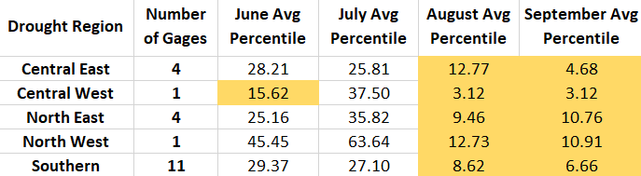
Percent by Drought Region

Slide 8
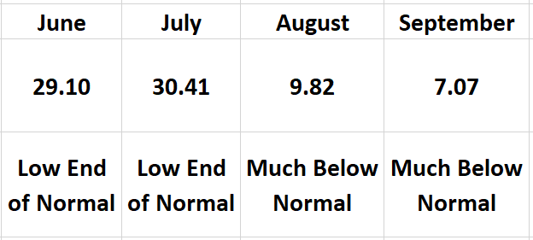
Statewide Average Percentages
Notes:
Period of Record instantaneous low flows at 6 sites
NOOSENECK RIVER AT NOOSENECK, RI
QUEEN R AT LIBERTY RD AT LIBERTY RI
PAWCATUCK RIVER AT KENYON, RI
PAWCATUCK RIVER AT WOOD RIVER JUNCTION, RI
PAWCATUCK RIVER AT WESTERLY, RI
NIPMUC RIVER
01114500 – Lowest in 2016 3.17, low now 4.26 – needs a revision for low being wrong
01115630 – lowest instant discharge on 09/19/2020. 01117370 – 2020/09/23 – 2.1, daily mean 2.24
01117430 – 2020/09/21 .45, daily mean 1.54, new control – not sure it’s a good comparison
01117500 – Lowest low flow ever at 7.4 in 1947, now its lowest flow is Sept 23 2020 6.03
01118500 – 2020/08/27 lowest instant flow 17.81
Mentionable
01116500 – 2016 12.8, 2020 – 08/04/2020 15.20 close but not quite

Slide 9
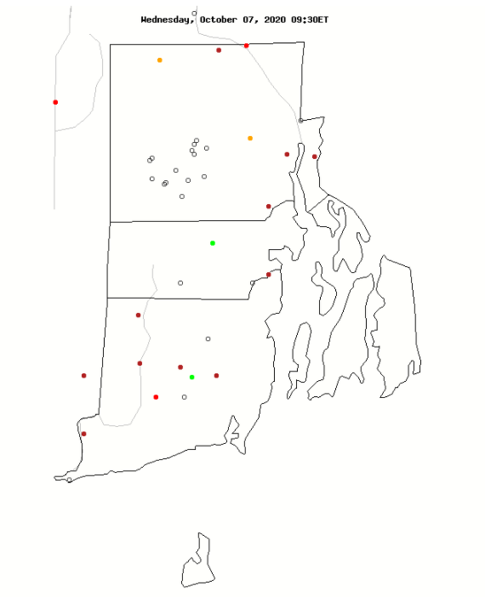
Current Streamflow Conditions – October 07, 2020

Slide 10
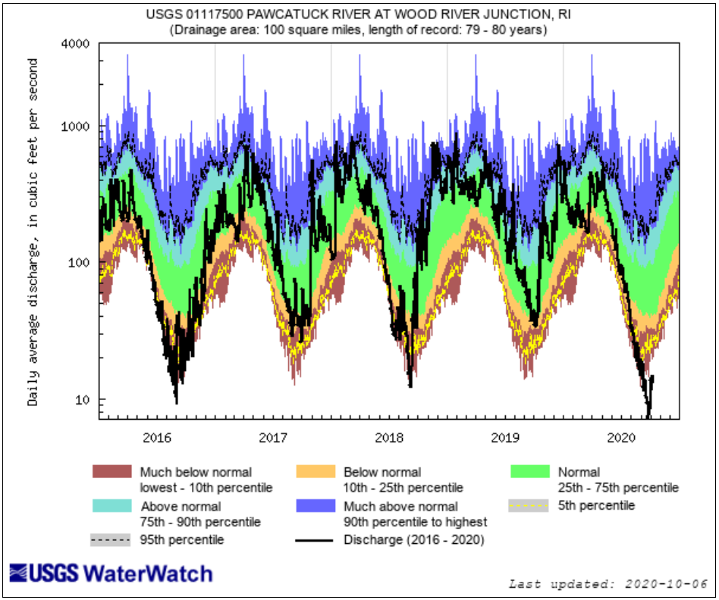

Slide 11
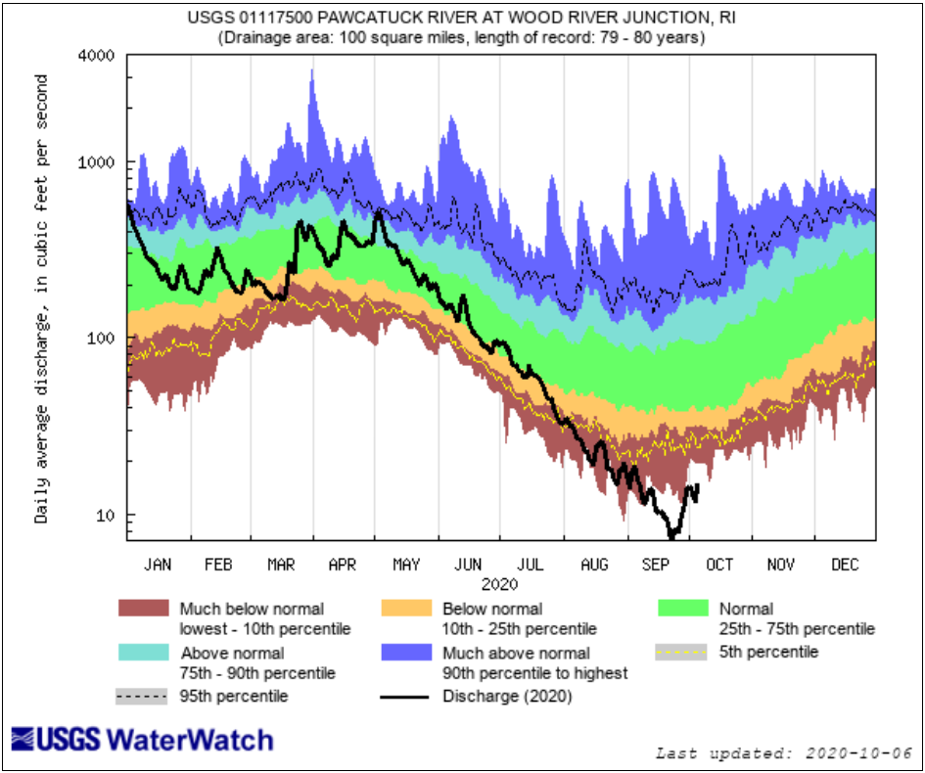
Notes:
POR in August and Most of September

Slide 12
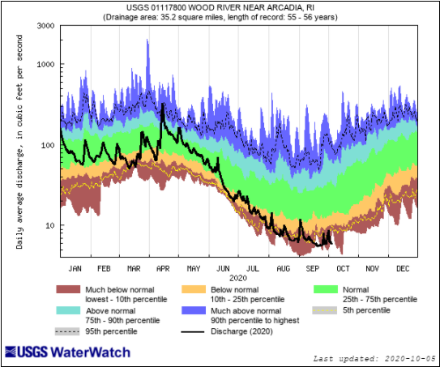
Notes:
POR for several days in September

Slide 13
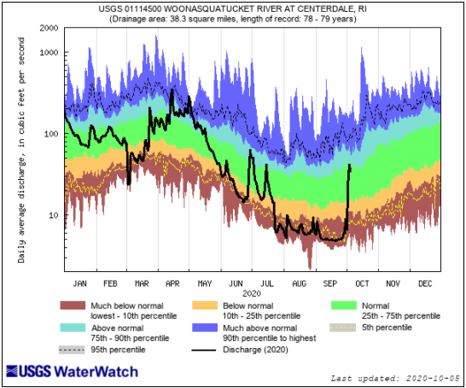
Notes:
Make sure to point out the POR in – 2 in August and 1 September

Slide 14
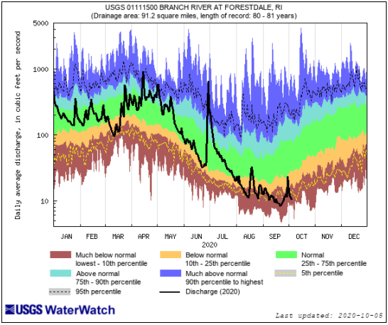

Slide 15
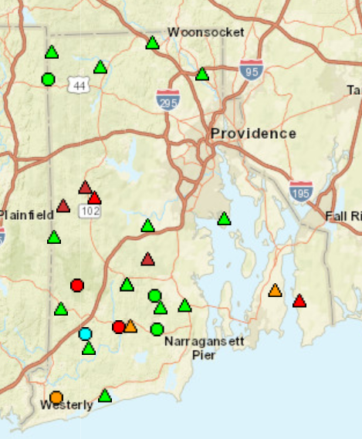
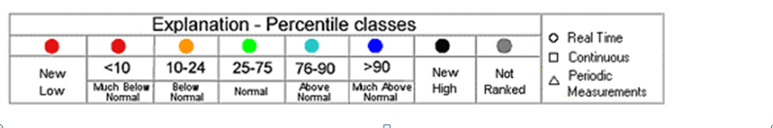
GW Conditions Late July, 2020
Notes:
Say similar to stream flow
Conditions are declining in general
Southern is mostly low

Slide 16
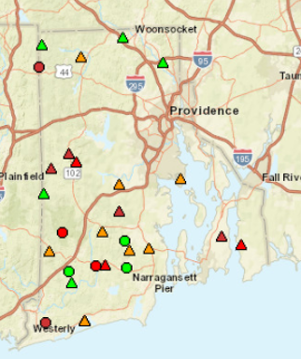
GW Conditions Late August, 2020
Notes:
Overall state average is much below normal.

Slide 17
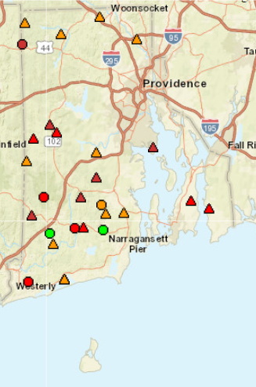
Conditions Late September 2020
Notes:
All discrete wells: 4 wells with records lows and 3 dry wells. Overall state average is much below normal.
Cow 342 record low – Total Well Depth = 13ft in Stratified Deposits (Central West)
Snw 1198 record low – Total Well Depth = 20.6ft in Stratified Deposits (Southern)
Ltw 142 record low – Total Well Depth = 23.1ft in Till (Eastern)
Cow 466 record low – Total Well Depth = 17.8ft in Till (Central West)
Exw 278 dry well – Total Well Depth = 23.9ft in Till (Southern)
Wgw 206 dry well – Total Well Depth = 9.6ft in Till (Central West)
Pow 551 dry well – Total Well Depth = 50.1ft in Till (Eastern)
https://groundwaterwatch.usgs.gov/NetMapT1L2.asp?ncd=crn&sc=44

Slide 18
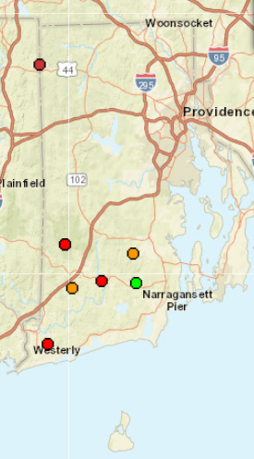
GW Real-time Conditions October 1, 2020

Slide 19
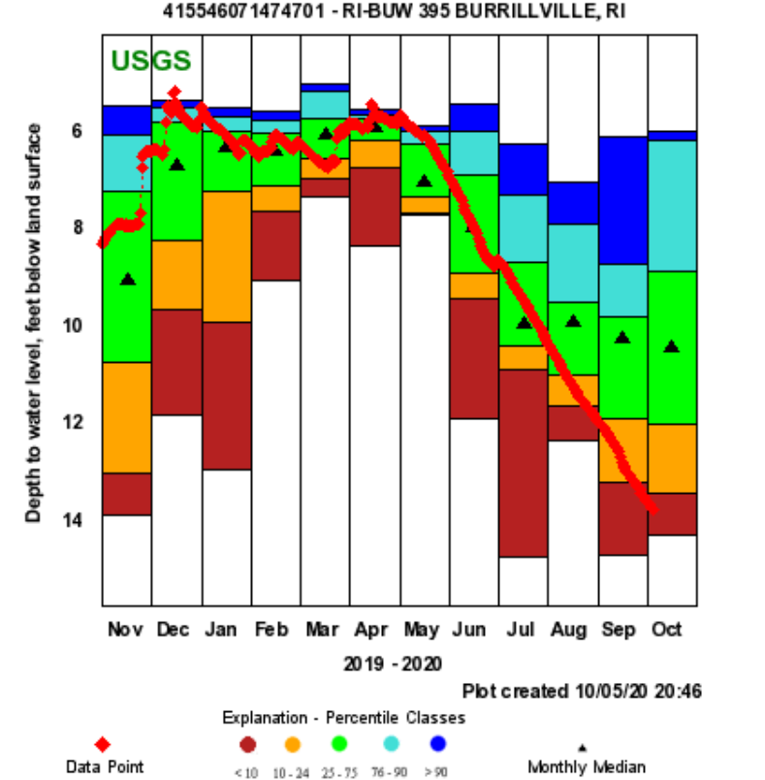

Slide 20
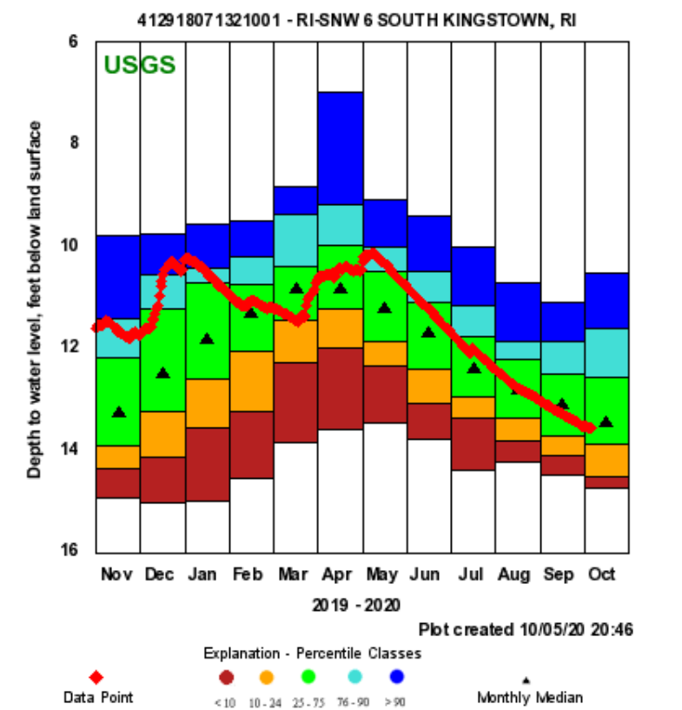

Slide 21
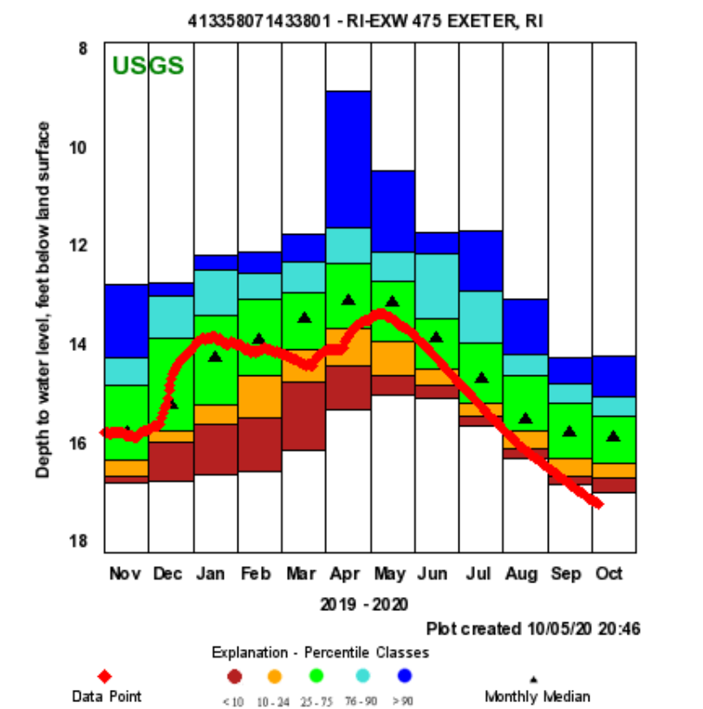
Notes:
POR lows for month of august and Sept

Slide 22
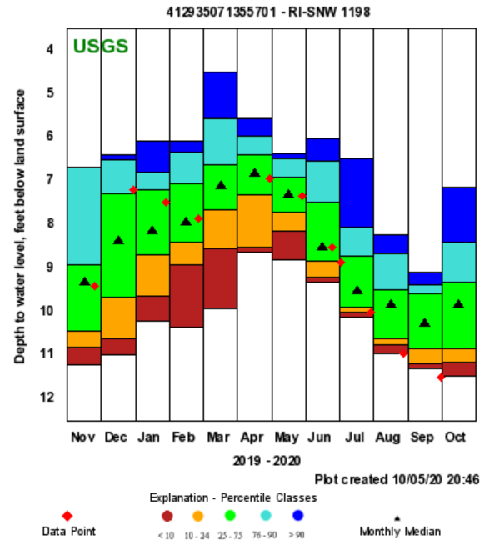
Notes:
POR low value – 25yrs of record

Slide 23
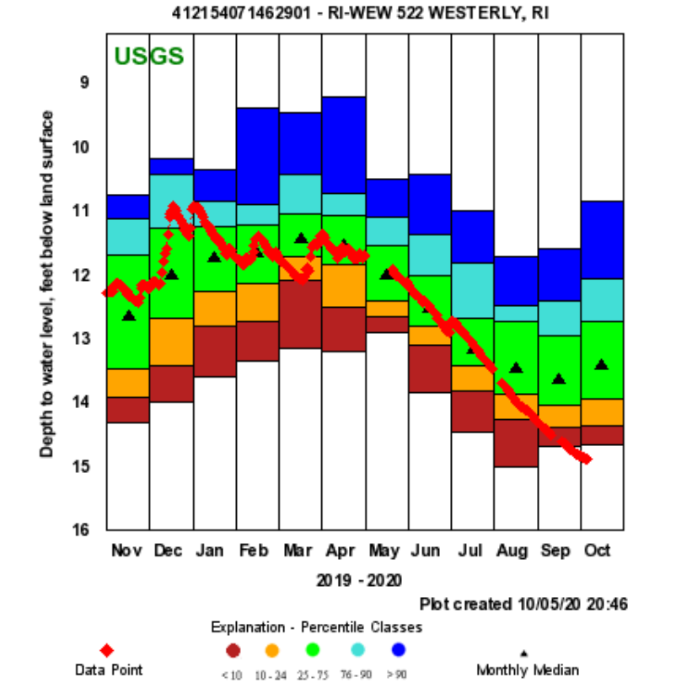
Notes:
Period of record low for realtime data 2008 – present - 14.89 lowest value 10/05
was discrete well and low was 14.99 in 1966

Slide 24
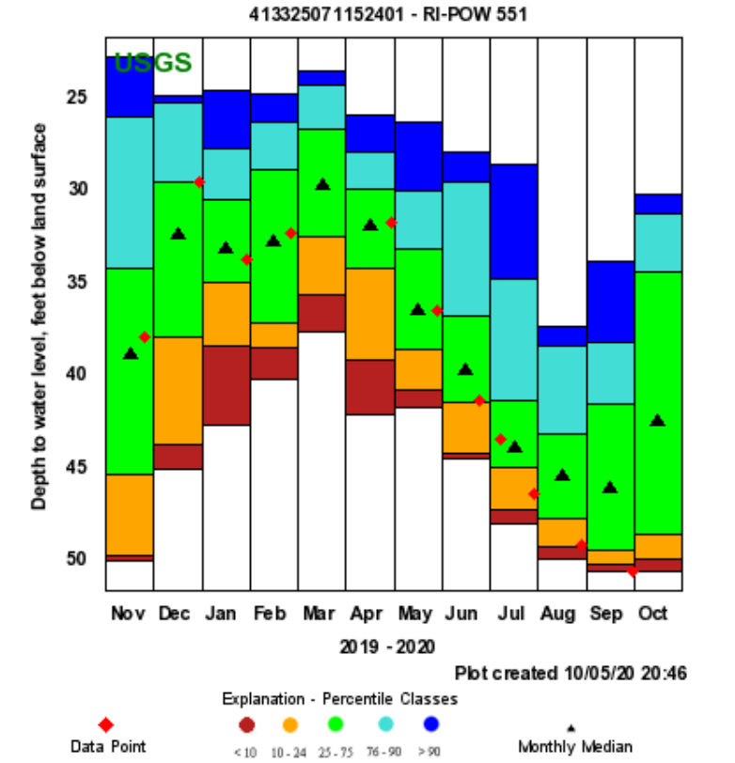
Notes:
DRY WELL State why they are single points and not continuous lines –

Slide 25
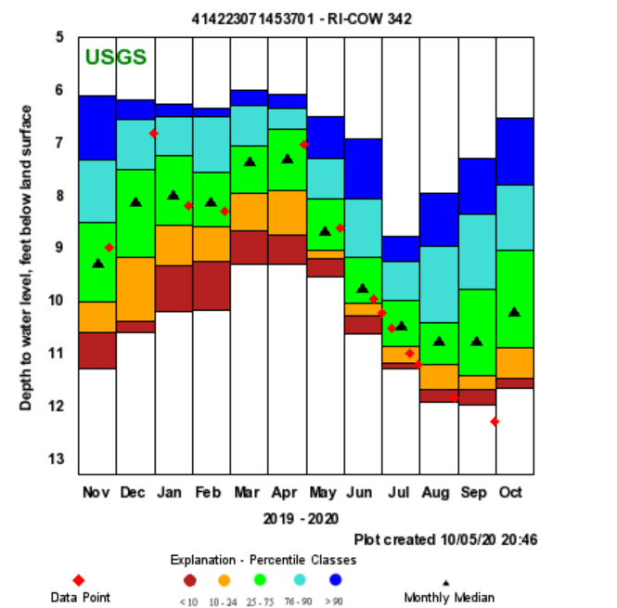
Notes:
Record low

Slide 26
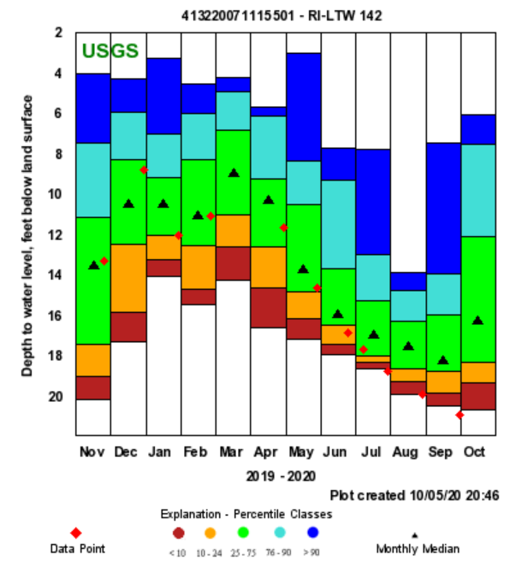
Notes:
POR record low flow – 28 years of record

Slide 27
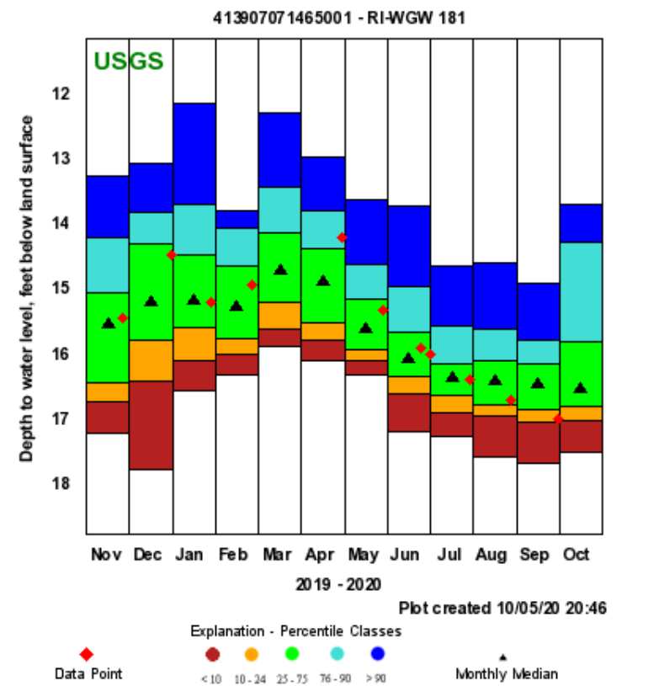

Slide 29
Summary: Streamflow -
Based on the State Guide Plan 721
  Drought advisory calls for three consecutive months of below normal streamflow
  Statewide the trigger has not been met.
    In general everything is trending down
    July had a mix 12 normal, 9 below normal streamgages (Statewide = 30%).
    August was much below normal statewide (9.82%).
    September was much below normal statewide (7.07%).
Notes:
Statewide basis normal
But areas of the state were below normal.

Slide 30
Summary: Ground Water -
Based on the State Guide Plan 721
  Drought advisory calls for two out of three months of below normal water levels
  The entire state does meet the trigger for a drought advisory.
  The average statewide condition for August and September was much below normal.

Slide 31
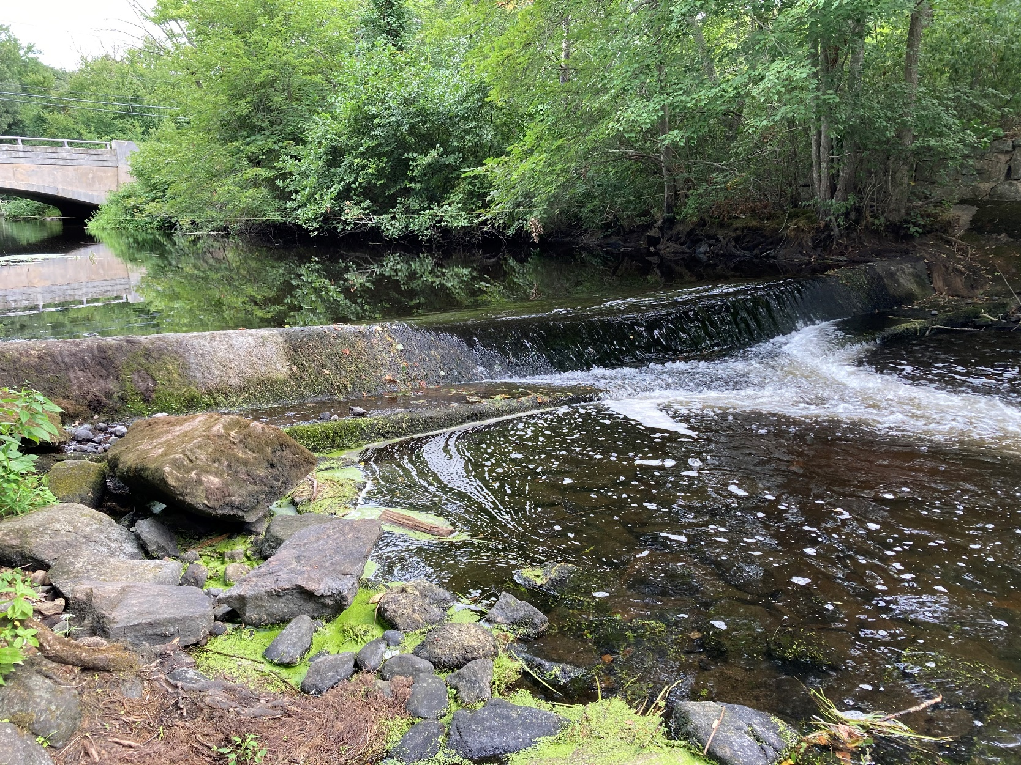
Questions?
Notes:
01117500 taken 08/27/2020

