Slide 1

Streamflow and Groundwater Conditions in Rhode Island
February 2021
C. Bruet
U.S. Geological Survey
New England Water Science Center

Slide 2
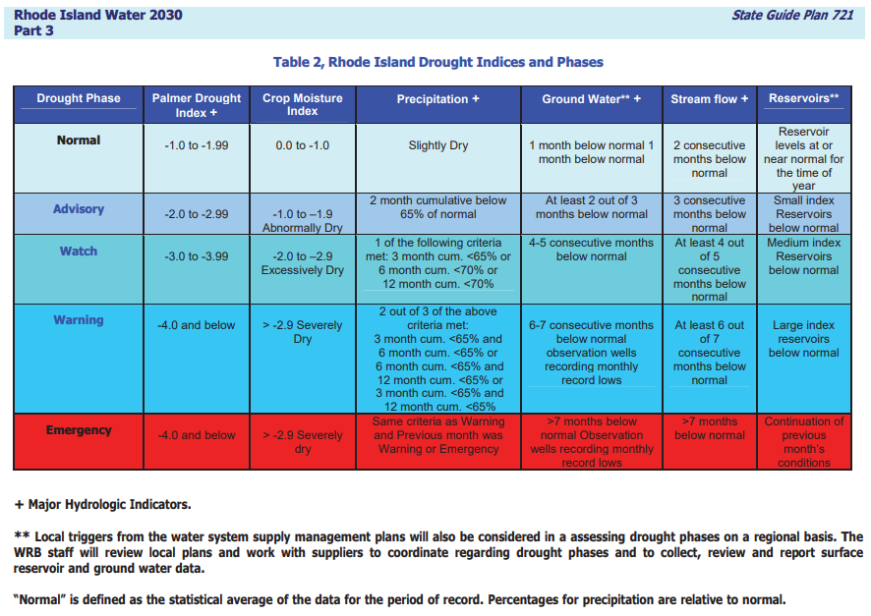


Slide 3
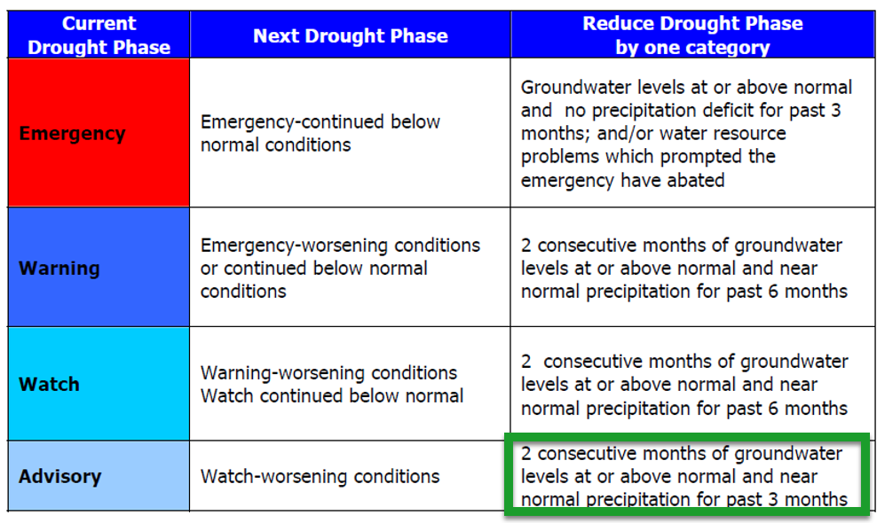

Slide 4
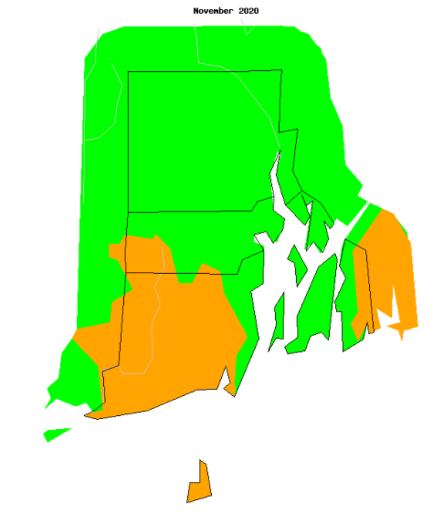
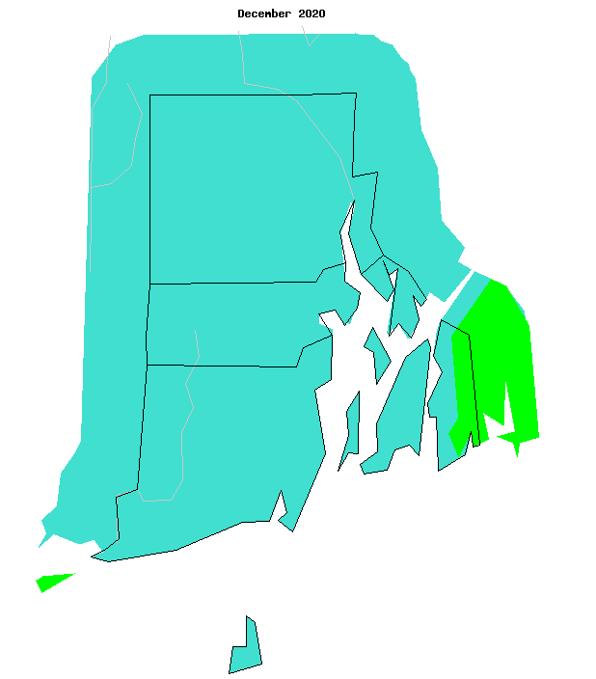
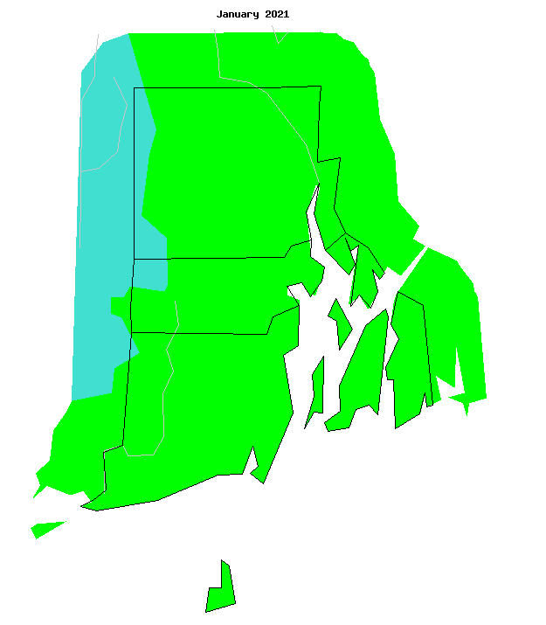
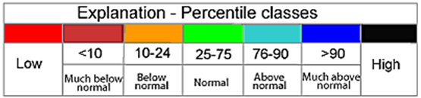
Average Streamflow Conditions
November – January
November
December
January

Slide 5
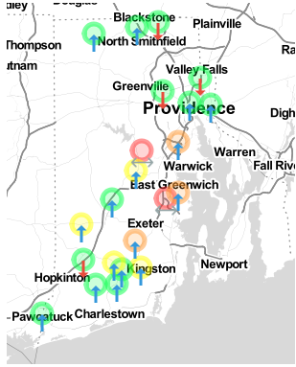
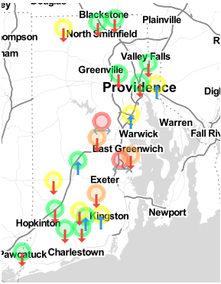

N-Day Maps as of 02/09/2021
7-Day
14-Day
Notes:
Maps generated on 02/09/2021 – maps made by WRB
Green is 36 – 75%
Yellow is between 25 – 35%
Orange is 10-25%
Red is <10%

Slide 6
Region Average Percentages
Drought Region | Number of Gages | Nov. 2020 Avg Percentile | Dec. 2020 Avg Percentile | Jan. 2021 Avg Percentile
Central East | 4 | 20.1 | 88.5 | 51.7
Central West | 1 | 32.3 | 51.5 | 27.3
North East | 4 | 41.9 | 76.8 | 71.9
North West | 1 | 10.7 | 58.9 | 71.4
Southern | 11 | 16.7 | 69.1 | 46.1

Slide 7
Statewide Average Percentages
November 2020 Avg Percentiles | December 2020 Avg Percentile | January 2021 Avg Percentile
22.6 | 72.9 | 52.4
Below Normal | Normal | Normal

Slide 8
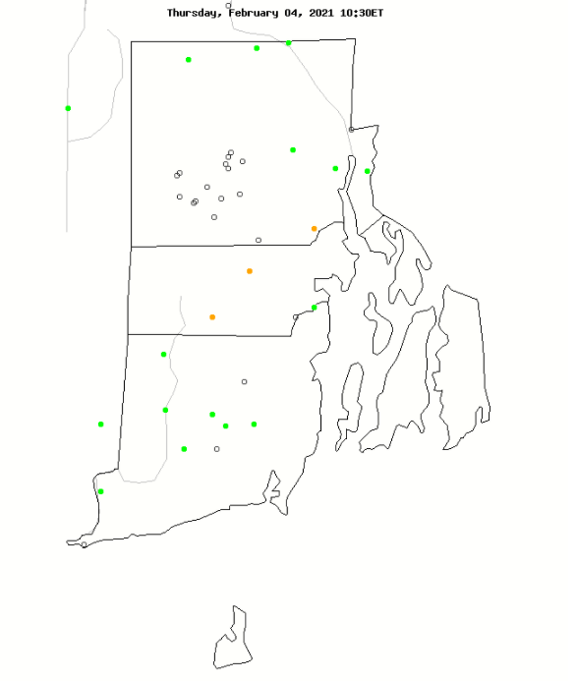
Current Streamflow Conditions – Feb 04, 2021
Notes:
State this is an average daily flow map compared to all other 11/05/2020 in history.
We already seeing decline from the recent rain events

Slide 9
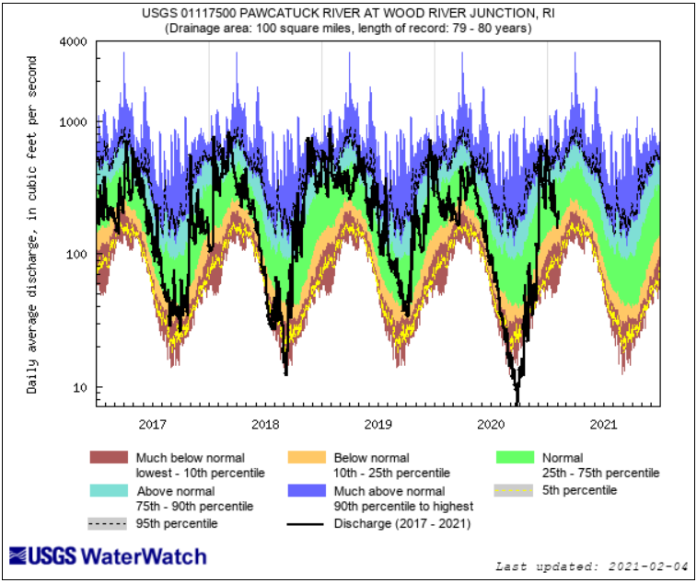
Notes:
5 year

Slide 10
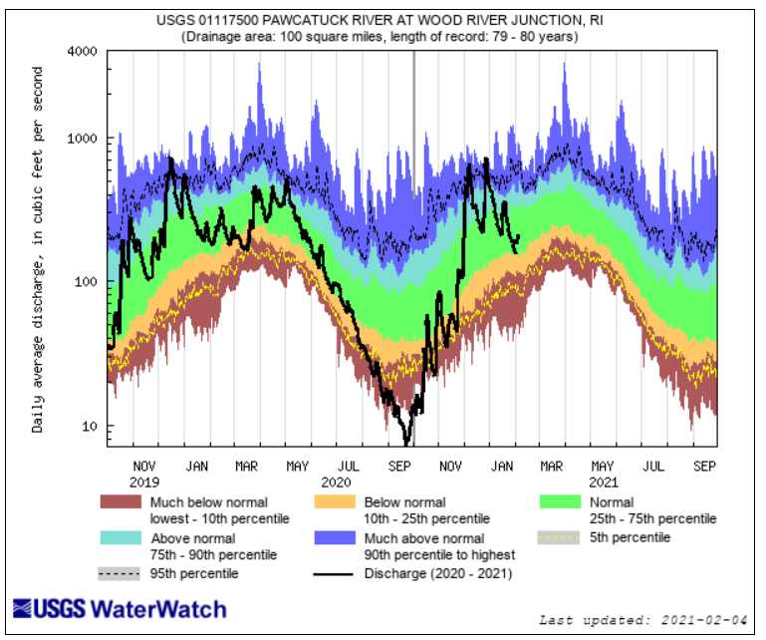

Slide 11
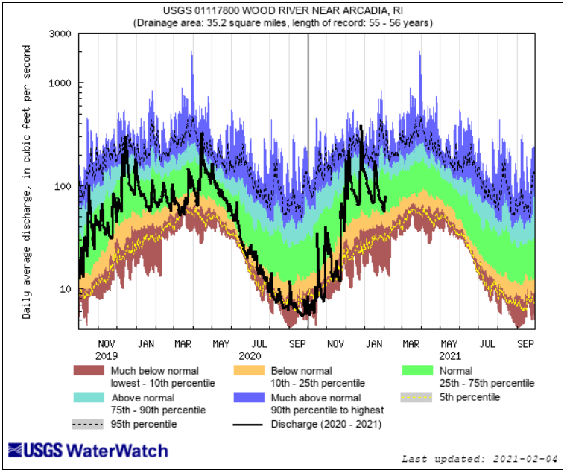

Slide 12
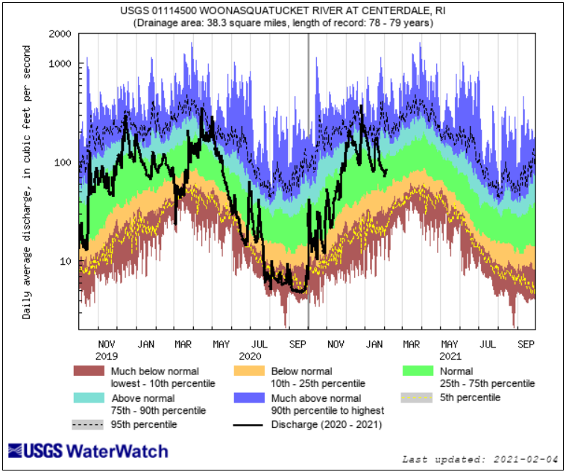

Slide 13
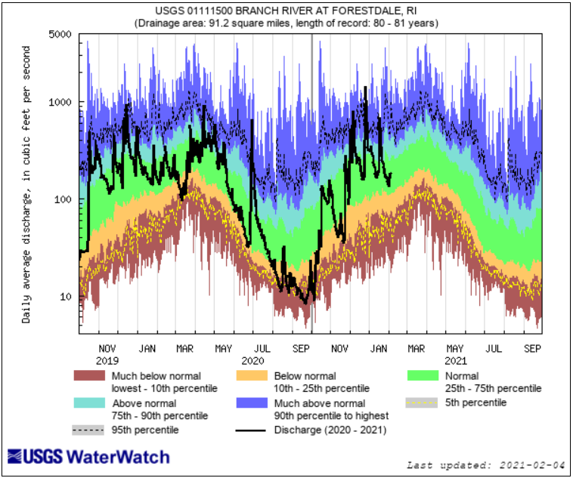

Slide 14
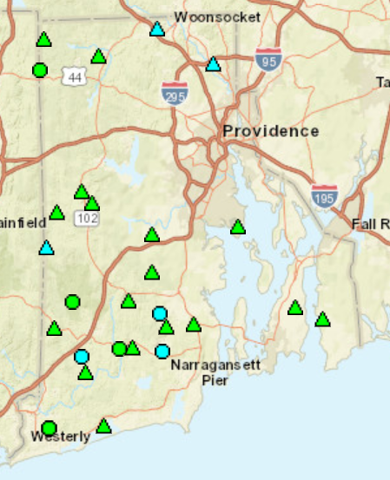
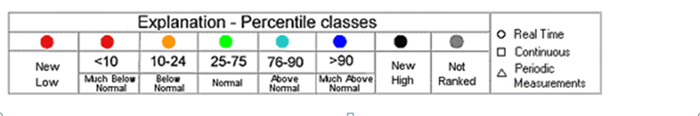
Groundwater Conditions
Late December
Notes:
The entire USGS Discrete GW entry program is being updated as a result we can’t enter any water new water levels until further notice.
All value for the month of January were at or above normal statewide.
Jan levels are all at or above normal.

Slide 15
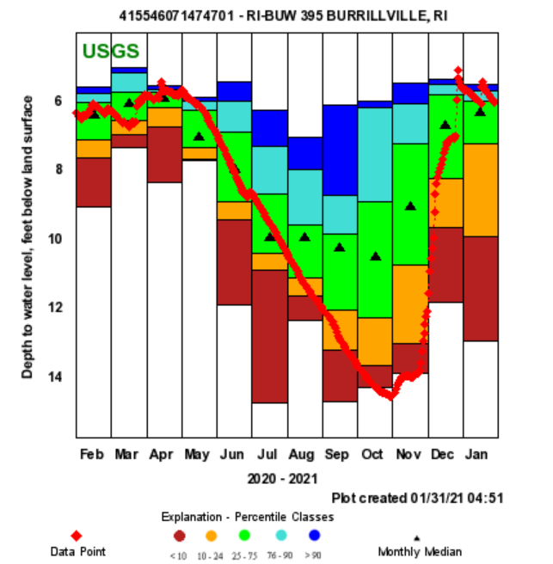

Slide 16
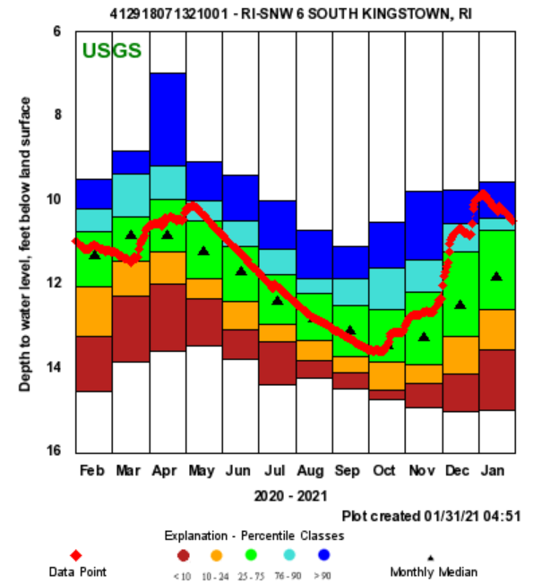

Slide 17
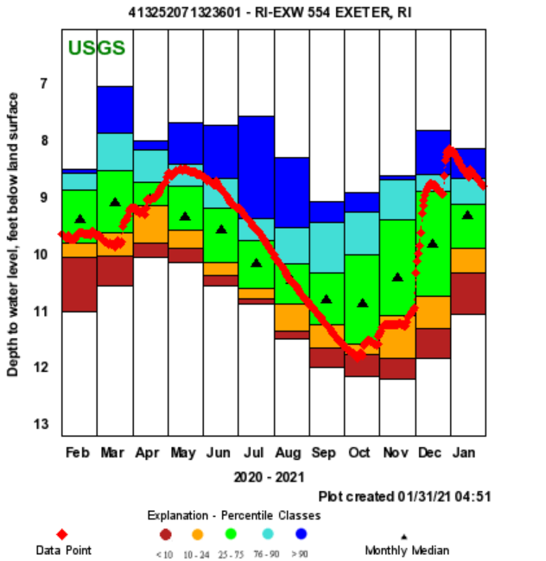
Notes:
POR for month of august

Slide 18
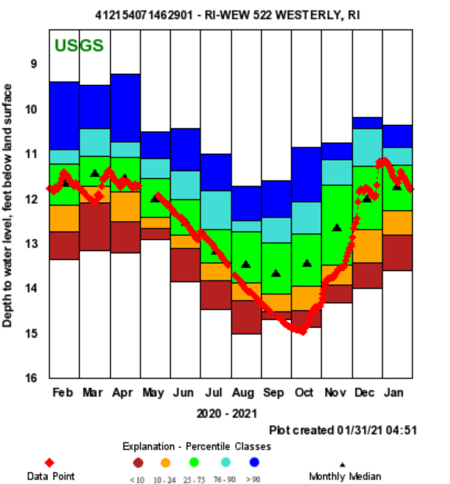

Slide 19
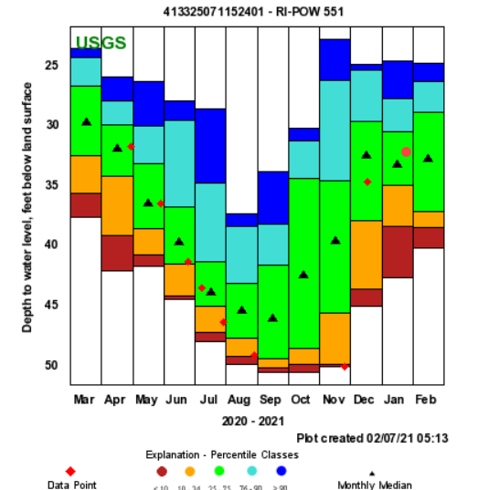
Notes:
Value 32.93

Slide 20
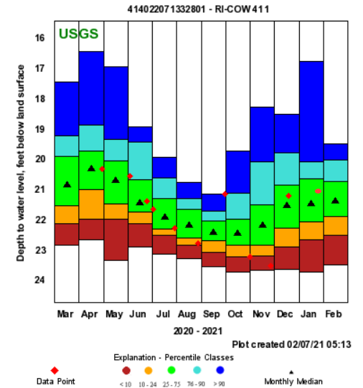
Notes:
Value 20.96

Slide 21
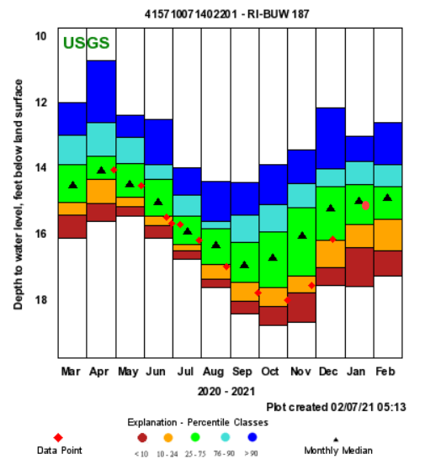
Notes:
Value 14.99

Slide 22
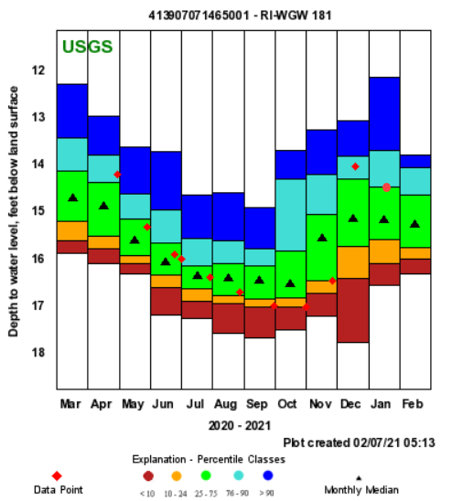

Slide 24
Summary: Streamflow -
Based on the State Guide Plan 721 there
  Drought advisory calls for three consecutive months of below normal streamflow
  Statewide November was slightly below normal or normal (22.6%)
  Statewide December and January were at or above normal (72.9%)

Slide 25
Ground Water Recovery

Slide 26
Summary: Ground Water -
Based on the State Guide Plan 721
  Drought recovery calls for two consecutive months at normal or above normal.
  Statewide November was below normal
  Statewide December and January were at normal or above normal.

Slide 27
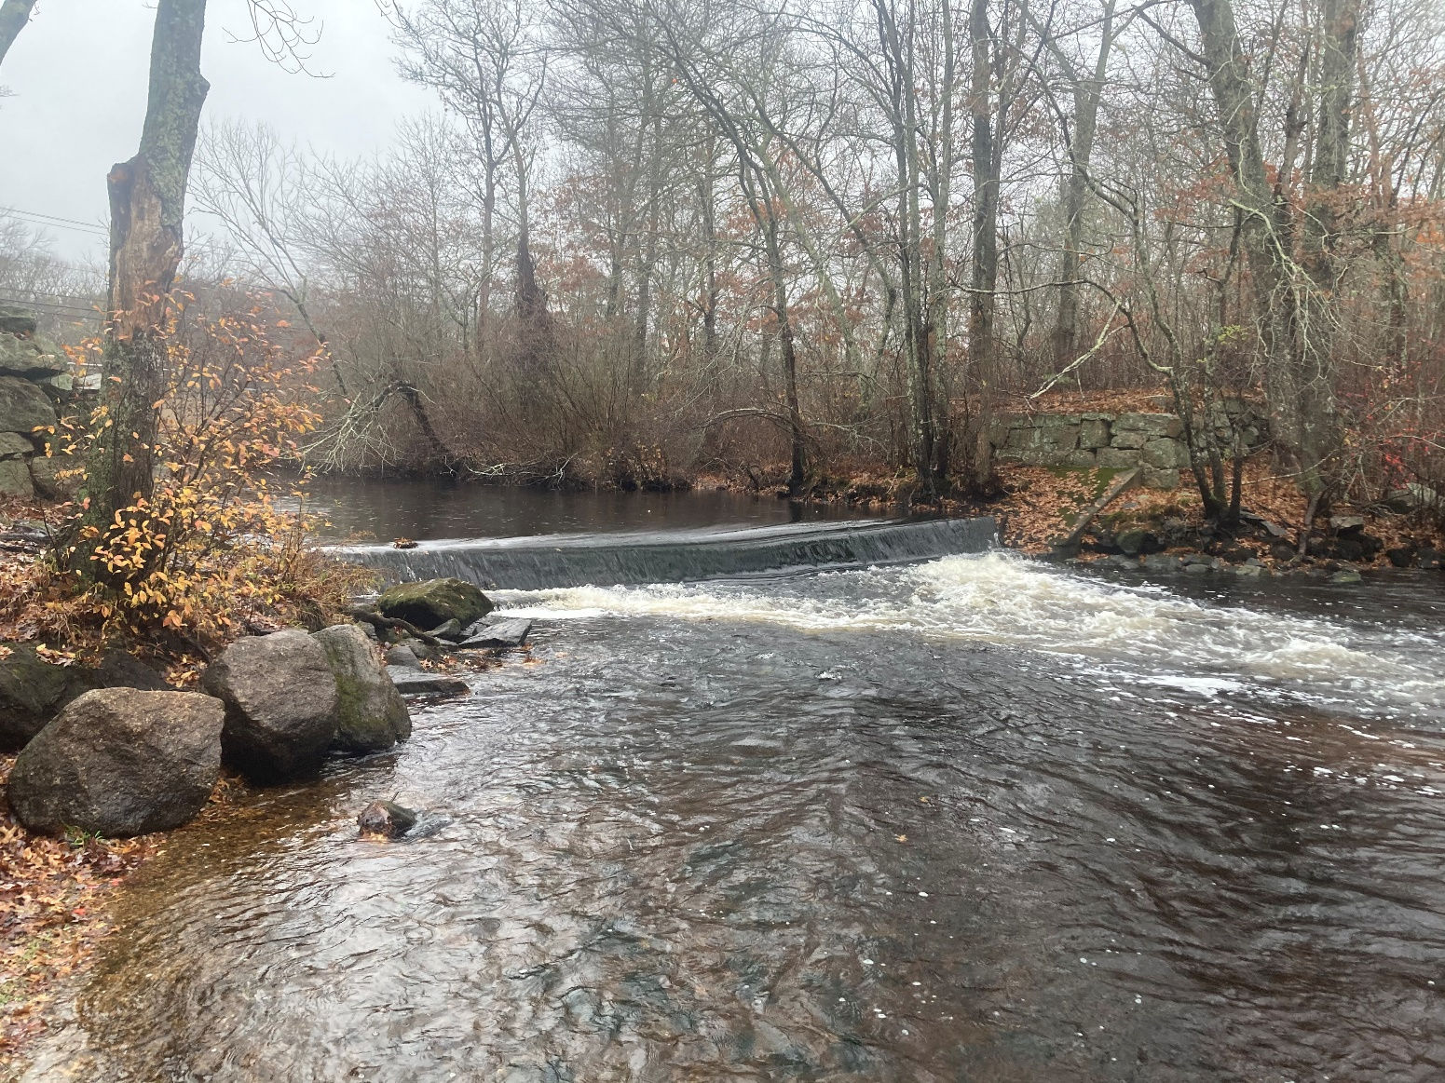
Questions?
Notes:
Wood River 11/11/2020 – waiting on pics from JD for this trips.

