Slide 1

Streamflow and Groundwater Conditions in Rhode Island
August 2022
G. Bent
U.S. Geological Survey
New England Water Science Center

Slide 2
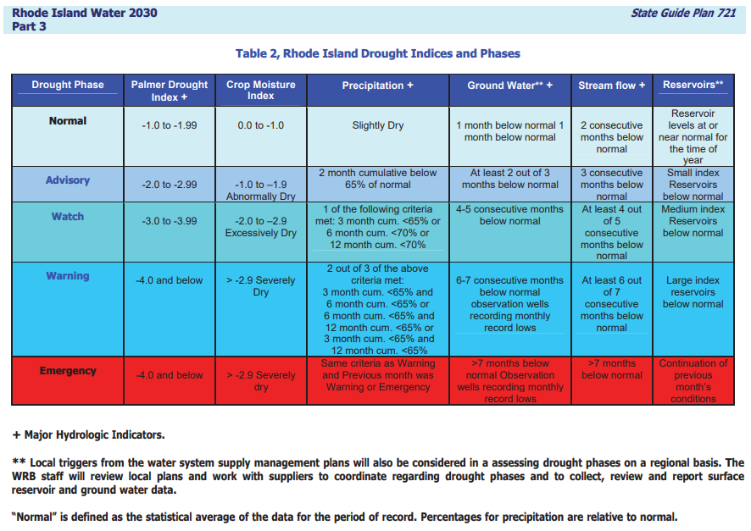


Slide 3
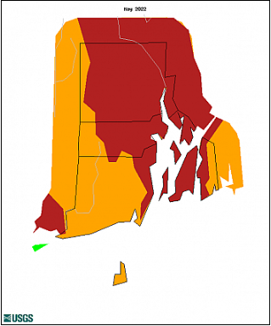
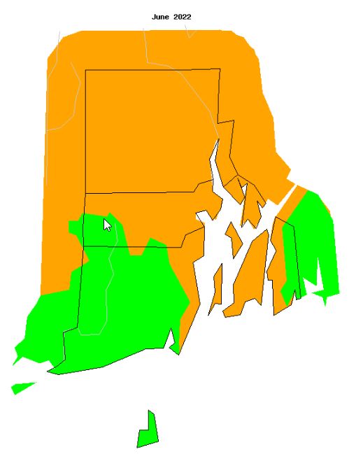
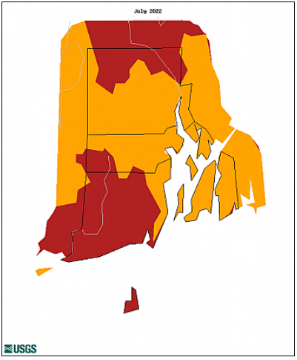
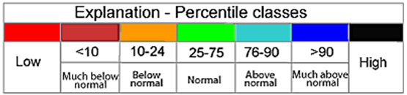
Average Streamflow Conditions
May – July
May
June
July

Slide 4
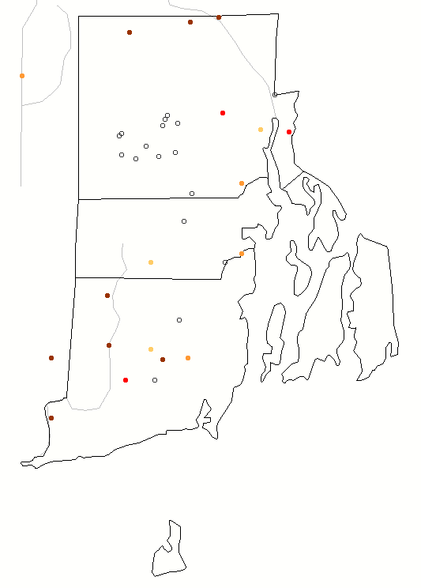

7 - Day Maps as of 08/07/2022
7-Day
Notes:
*****Grab water watch 7-day q map for Aug 8

Slide 5
Region Average Percentages
Regions | 03/2022 | 04/2022 | 05/2022 | 06/2022 | 07/2022
Northwest | 61 | 39 | 5 | 11 | 11
Northeast | 59 | 38 | 11 | 9 | 9
Central West | 35 | 20 | 14 | 40 | 43
Central East | 45 | 47 | 6 | 13 | 24
Eastern | No Gages-------------------------------------------------------------------------
Southern | 57 | 31 | 17 | 30 | 14
New Shoreham | No Gages-------------------------------------------------------------------------
Statewide | 55 | 35 | 13 | 22 | 16
*Pawcatuck at Wood River Junction, March=61%, April =41%, May=23%, June=25%, July=6%
Notes:
Streamflow = Advisory (Three consecutive months below 25%)
Looking at past 5 months to show full situation

Slide 6
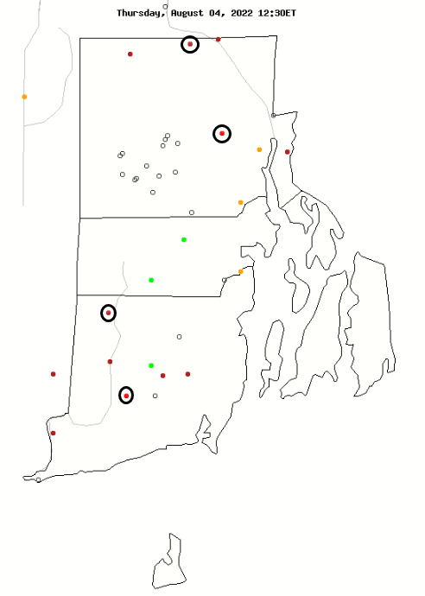
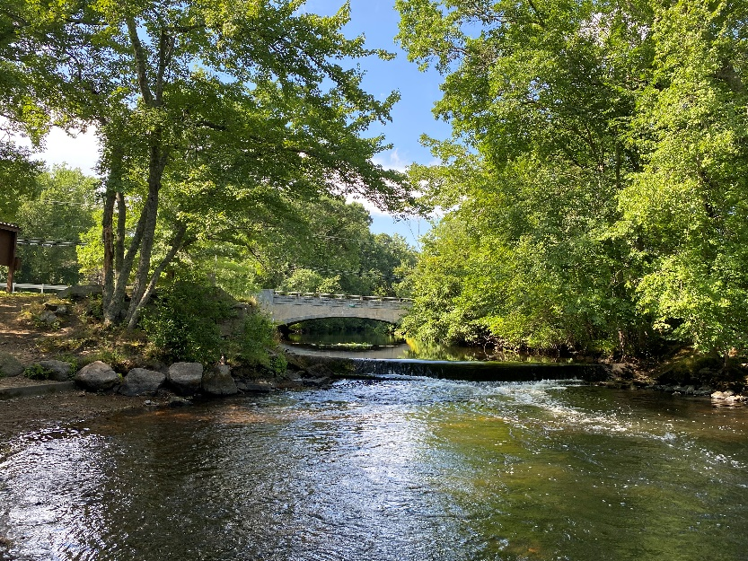
Current Streamflow Conditions – August 04, 2022
Notes:
State this is an average daily flow map compared to all other 08/03/2022 in history.
The circled gages are what will be shown is the following slides
Photo is 01117500 on 08/02/2022

Slide 7
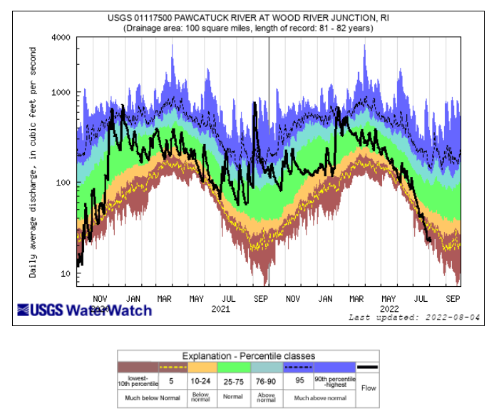
Notes:
01117500
Graph generated on 07/29/2022
2 year daily plot

Slide 8
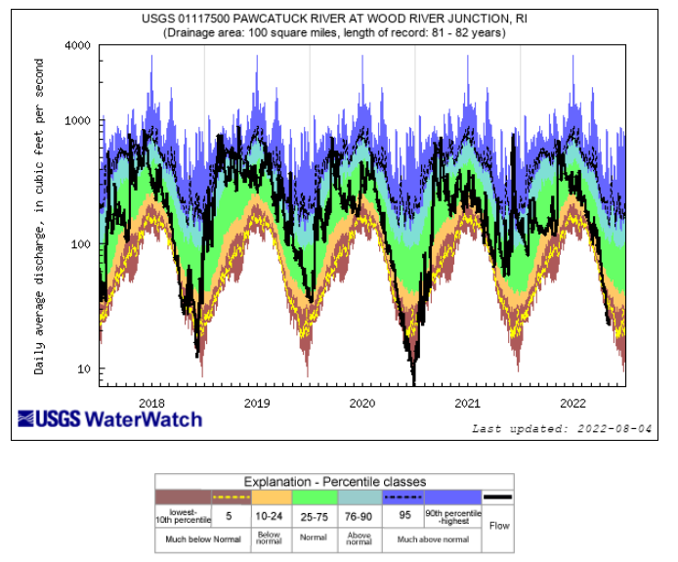
Notes:
01117500
Graph generated on 07/29/2022
5 year daily plot

Slide 9
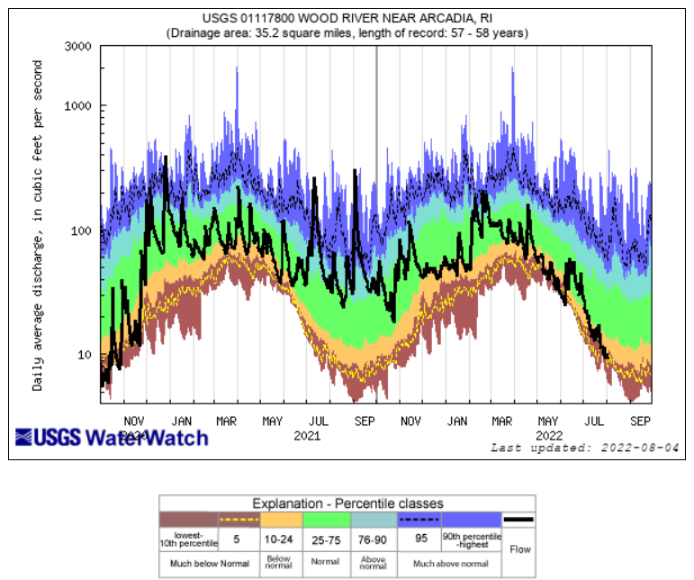
Notes:
01117800
Graph generated on 07/29/2022
2 year

Slide 10
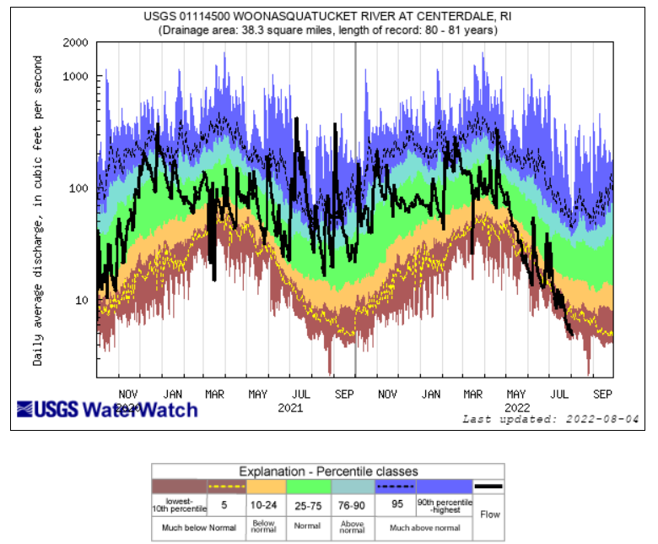
Notes:
01114500
Graph generated on 07/29/2022
2 year

Slide 11
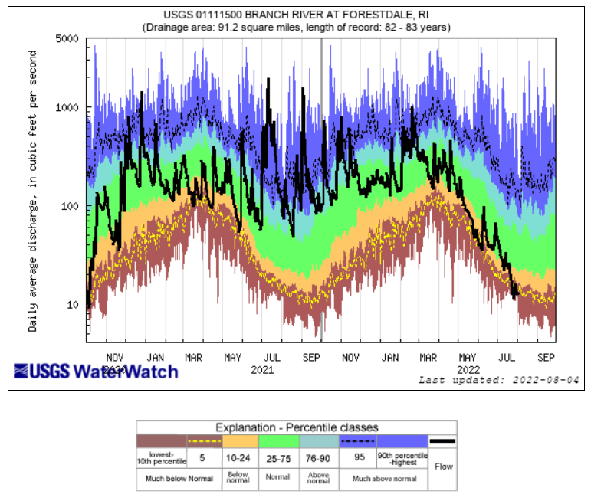
Notes:
01111500
Graph generated on 08/03/2022
2 year plot

Slide 12
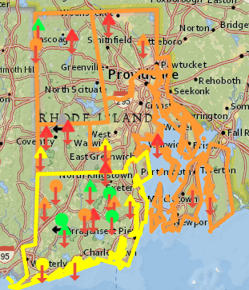
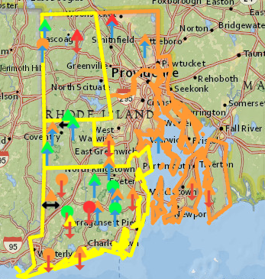
Groundwater Conditions
End of May 2022
End of June 2022
Notes:
Images from RI WRB

Slide 13
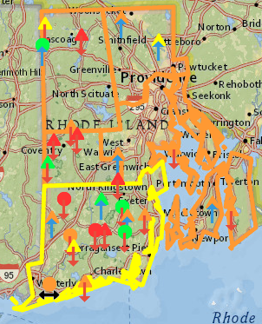
Groundwater Conditions
July 2022
Notes:
The circled gages are what will be shown in the following slides
**Will add WRB once stats are updated.
Left is RI dashboard image

Slide 14
Average Groundwater Conditions
March – July
Regions | GW 3/2022 | GW 4/2022 | GW 5/2022 | GW 6/2022 | GW 7/2022
Northwest | 52 | 43 | 19 | 31 | 22
Northeast | 31 | 52 | 12 | 16 | 23
Central West | 35 | 31 | 10 | 27 | 14
Central East | 41 | 32 | 14 | 20 | 20
Eastern | 33 | 37 | 17 | 15 | 17
Southern | 55 | 44 | 33 | 30 | 26
New Shoreham | No Wells---------------------------------------------------------------------------
Statewide | 47 | 41 | 24 | 27 | 22
Notes:
Groundwater = Advisory (Two out of past three months below 25%)

Slide 15
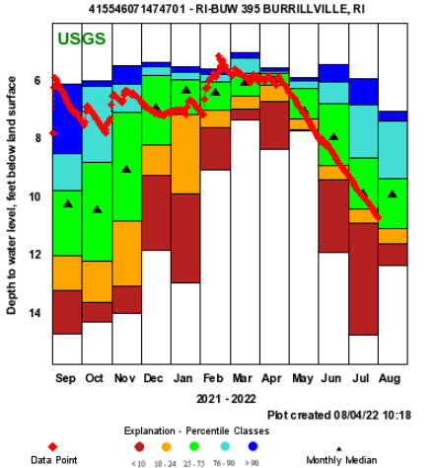
Notes:
BUW 295

Slide 16
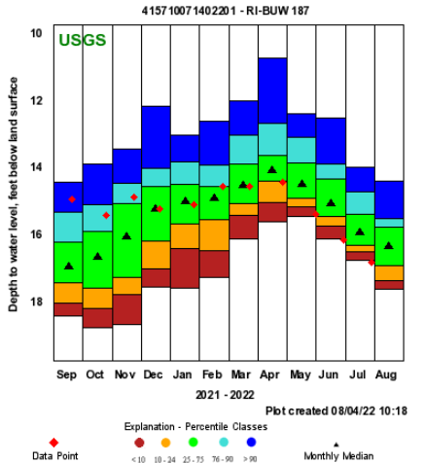
Notes:
BUW 187

Slide 17
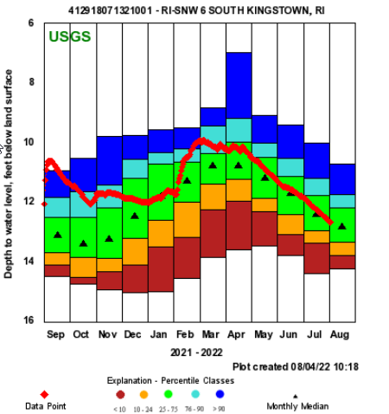
Notes:
SNW 6

Slide 18
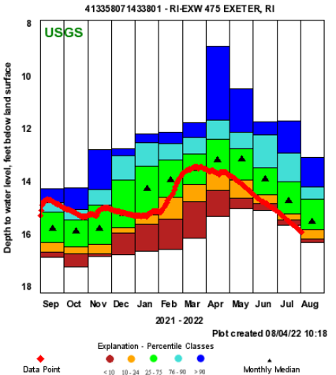
Notes:
EXW 475

Slide 19
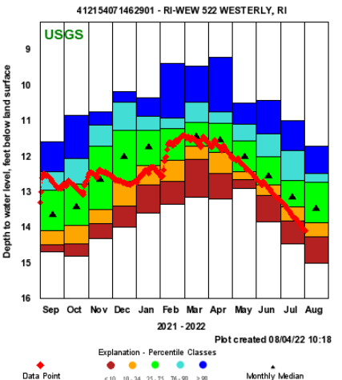
Notes:
WEW 522

Slide 20
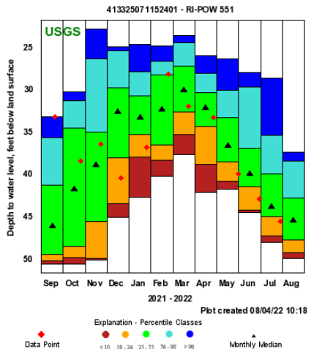
Notes:
POW 551

Slide 21
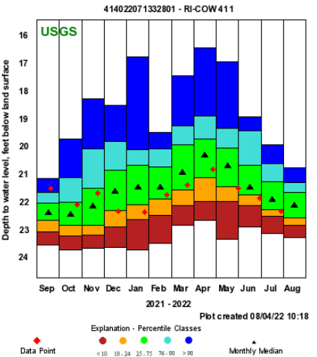
Notes:
COW 411

Slide 22
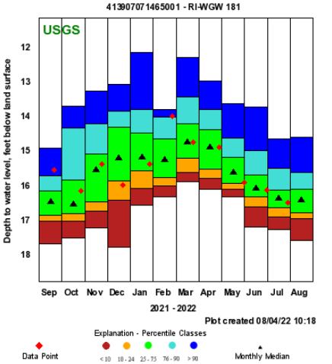
Notes:
WGW 181

Slide 24
Summary: Streamflow - Recap
Based on the State Guide Plan 721 there
  Drought advisory calls for three consecutive months of below normal streamflow
    May 13%
    June 22%
    July 16%
Notes:
Use Tim’s slides

Slide 25
Summary: Groundwater - Recap
Based on the State Guide Plan 721 there
  Drought advisory calls for at least two out of 3 months of below normal.
    May 24%
    June 27%
    July 22%
Notes:
Use Tim’s slides

Slide 26
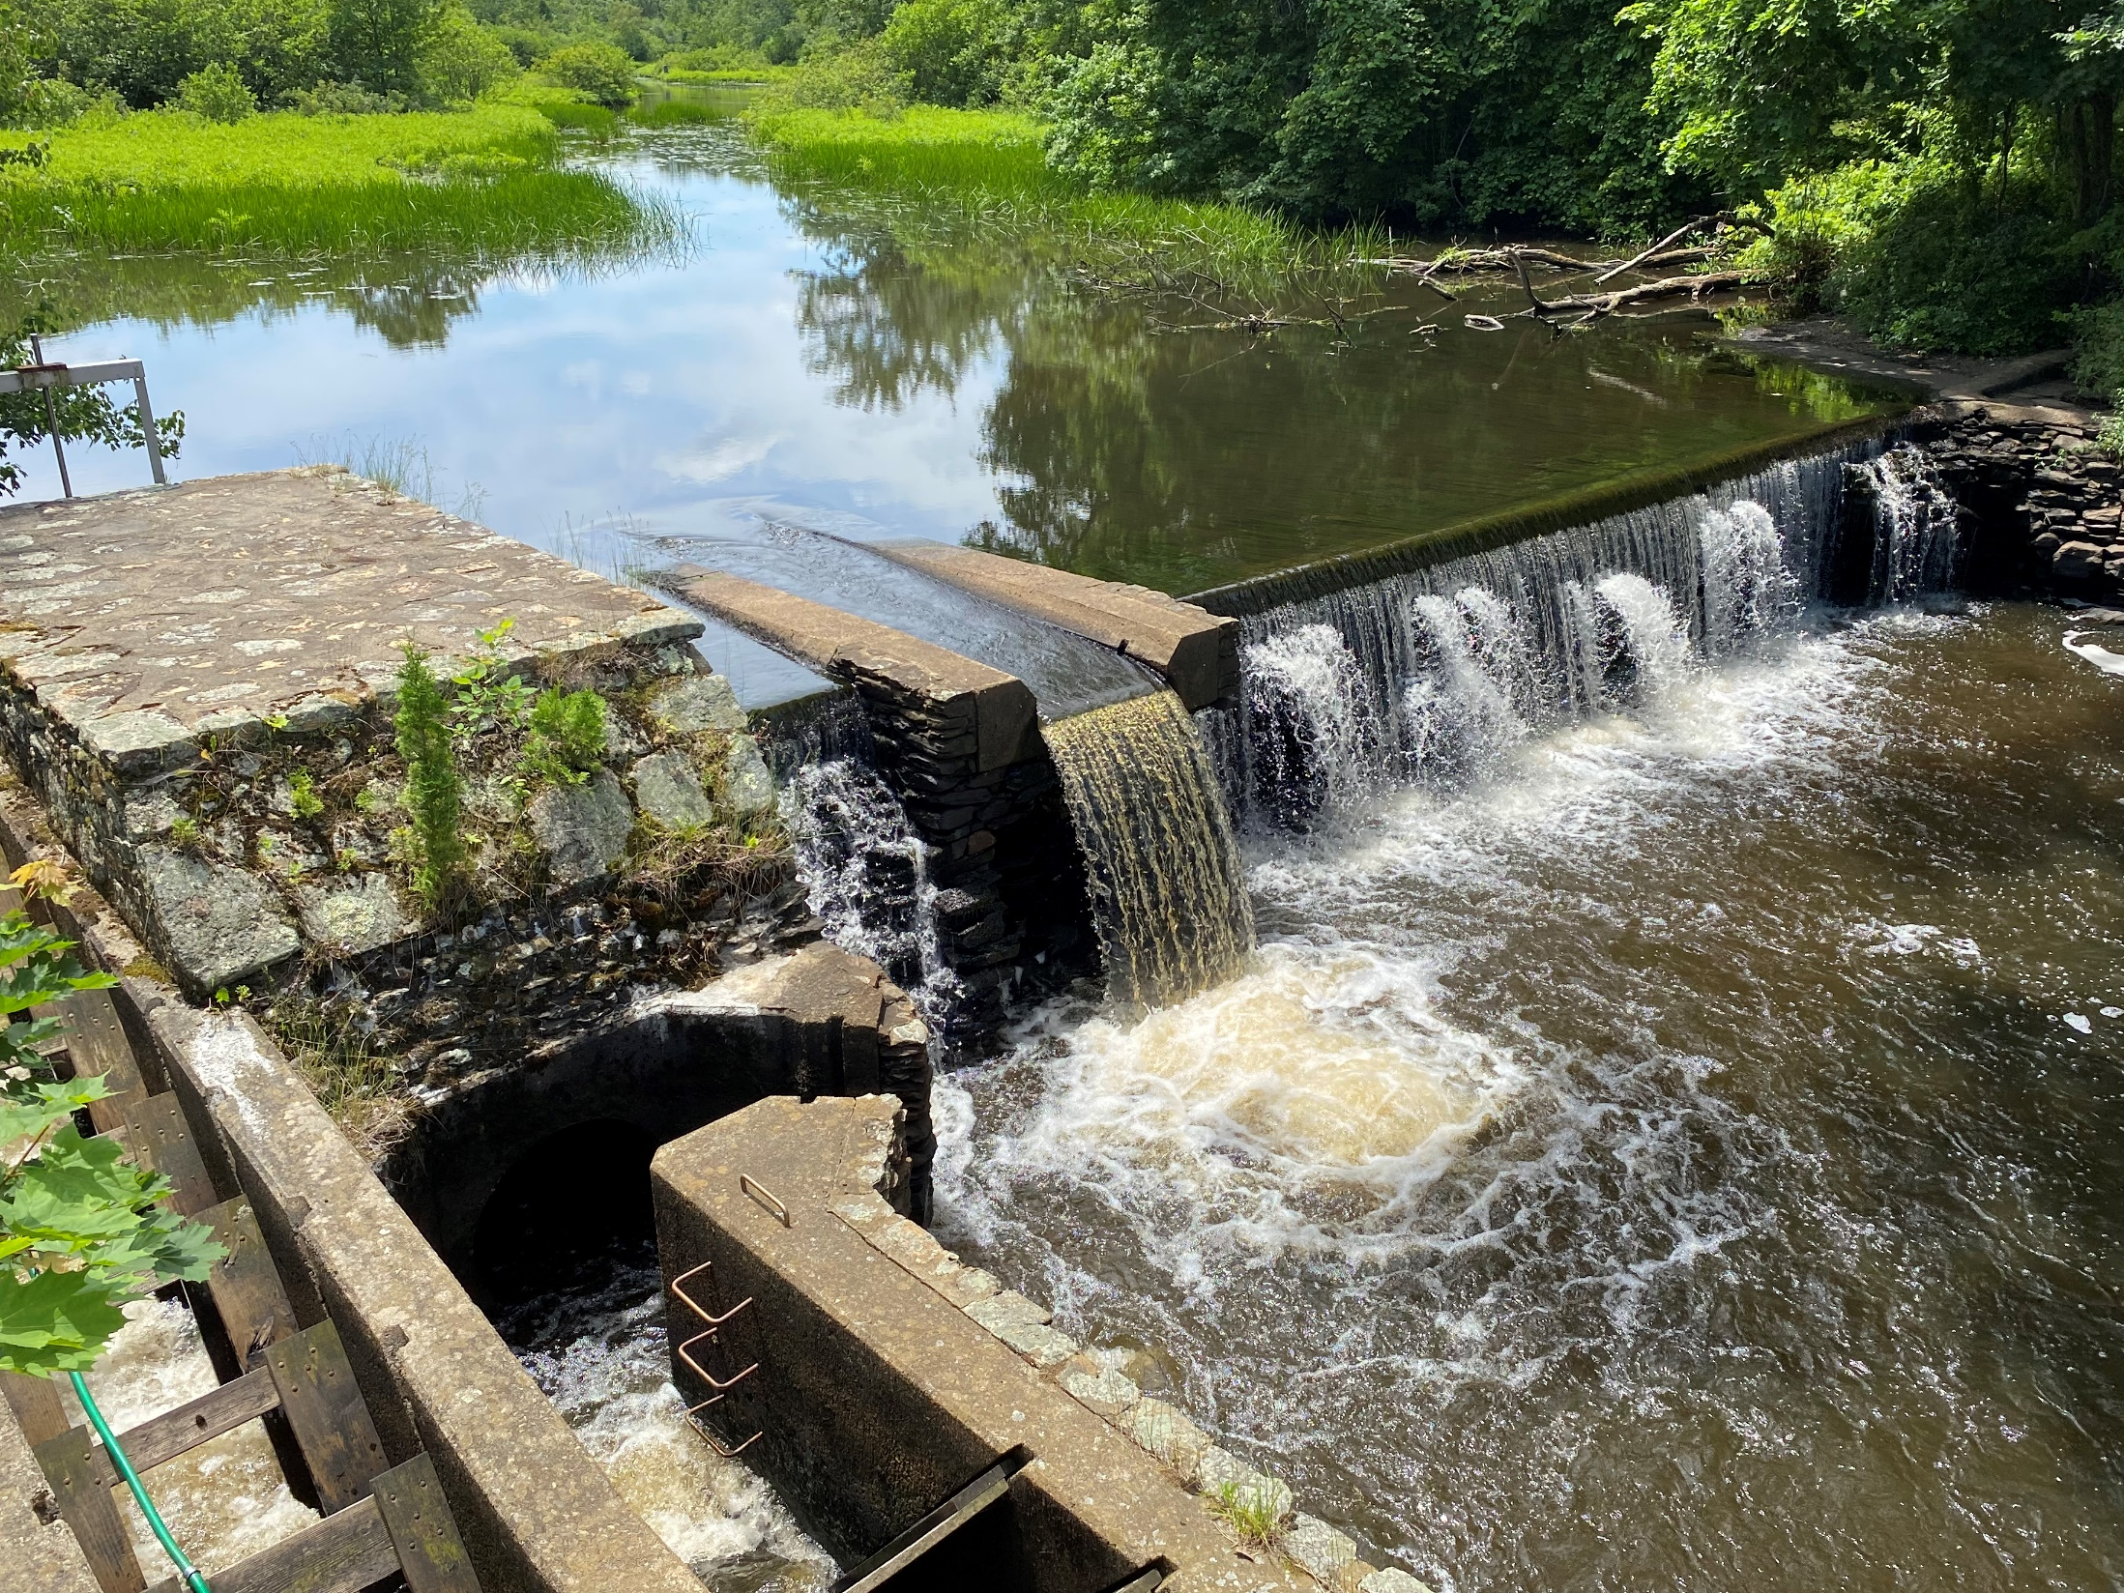
Questions?
Notes:
01117000 06/30/2022

