Slide 1
RI Drought Steering Committee Meeting
NWS Update
National Weather Service Boston/Norton MA
October 8, 2020

Slide 2
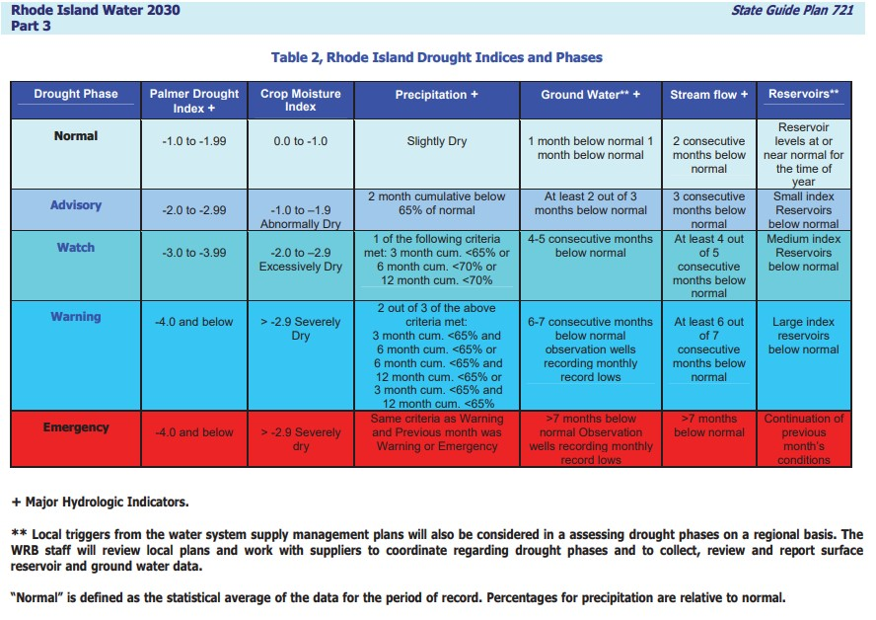
Drought Indices From Rhode Island Water 2030 Document
Notes:
This NWS presentation will provide details for the following Drought Indices: Precipitation, Palmer Drought Index, and Crop Moisture Index.

Slide 3
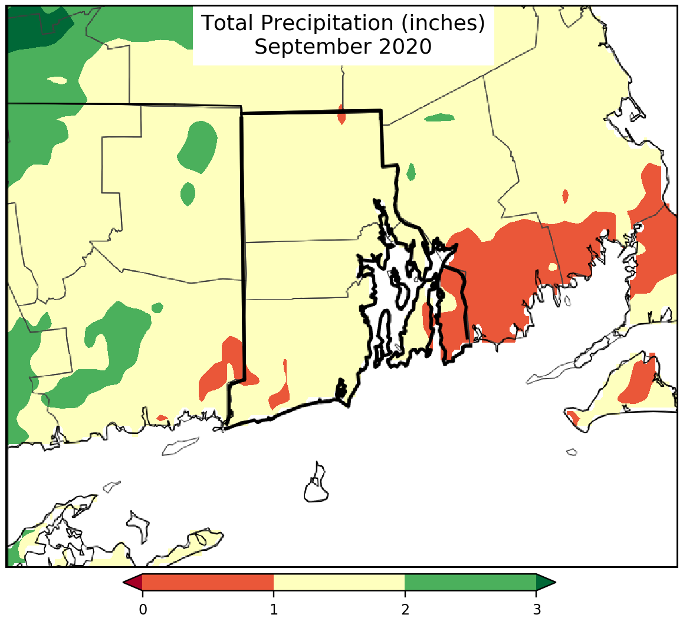
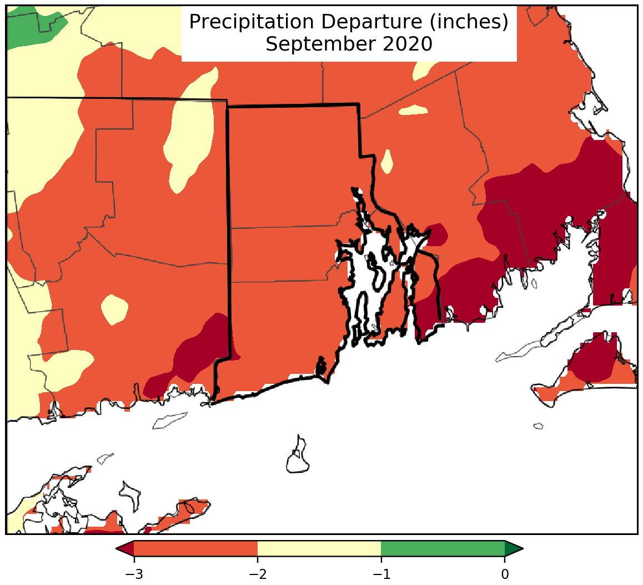
September 2020 Rainfall and Departure

Slide 4
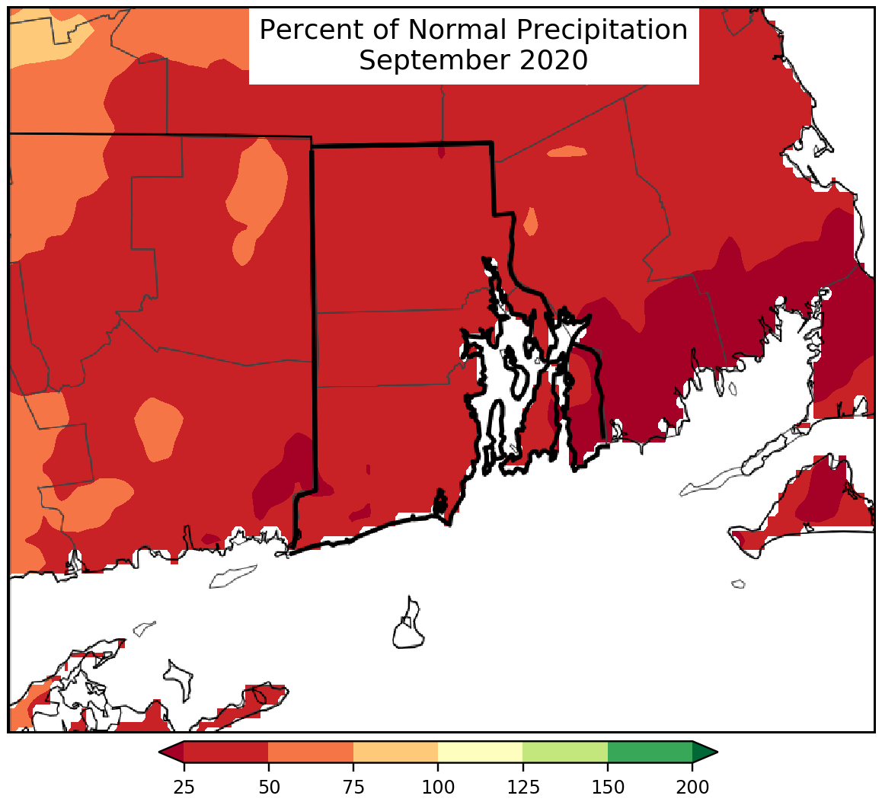
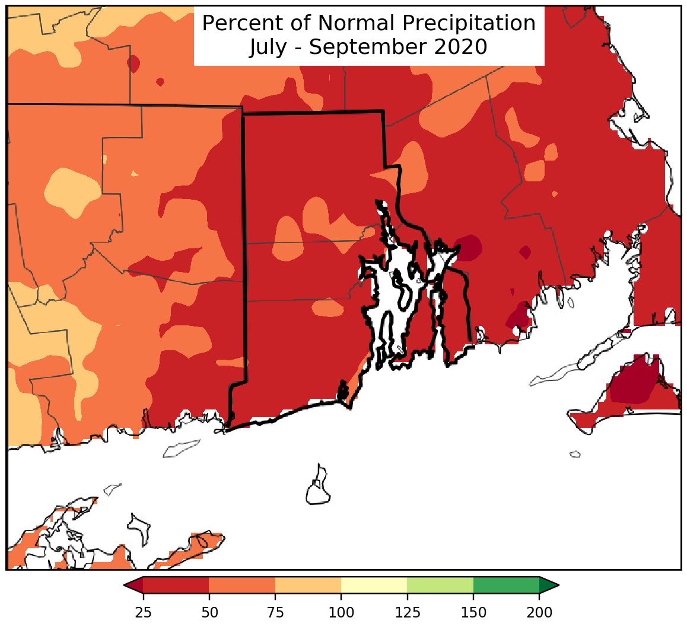
Sep and Jul-Sep Percent of Normal

Slide 5
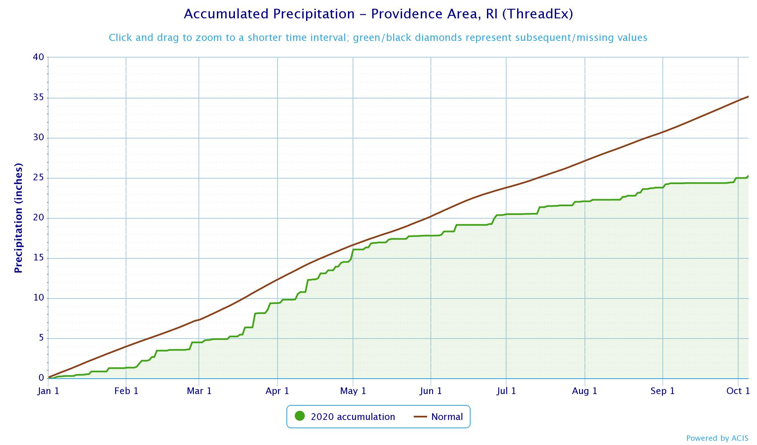
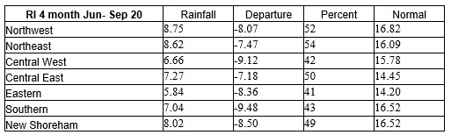
Graph showing 2020 Year-to-date precipitation for Providence/TF Green.
Green line shows cumulative rainfall
Brown line shows normal cumulative rainfall.
Total rainfall from 1/1/20-10/5/20: 25.25”
Departure from normal: -9.90”

Slide 6
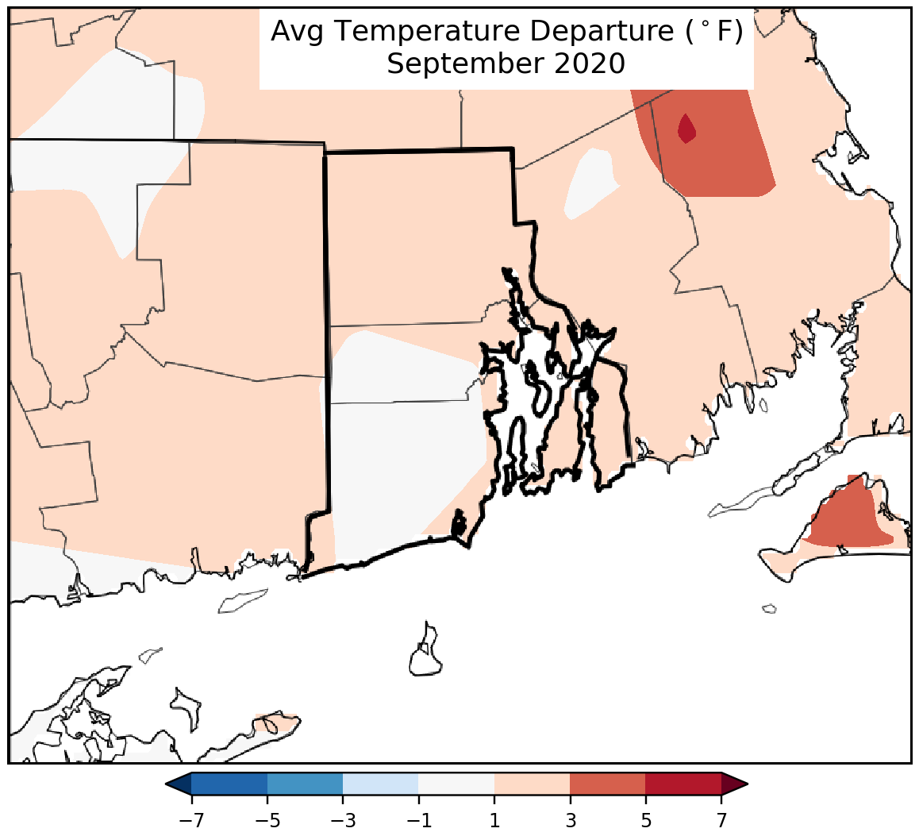
Temperature Departure from Normal
Unlike the previous 2 months, September temperatures were closer to normal.
Providence/TF Green averaged 1.3 degrees above normal
Kingston COOP site averaged 0.9 degrees above normal

Slide 7
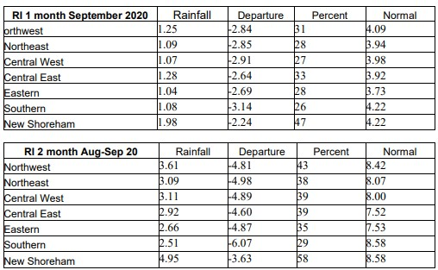
Sep and Aug-Sep Rainfall by Region
Corresponding Drought Phase for 2 months
<65% of normal:
Drought Advisory

Slide 8
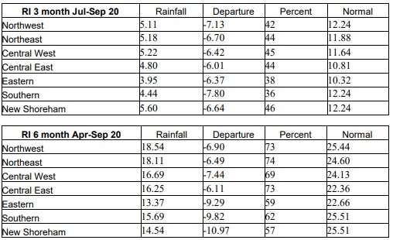
3 and 6-Month Rainfall by Region
Drought Watch
Corresponding Drought Phase for 3 months <65% of normal
All Regions Met Criteria
Drought Warning criteria (3 and 6 month <65% of normal):
Eastern, Southern,
New Shoreham

Slide 9
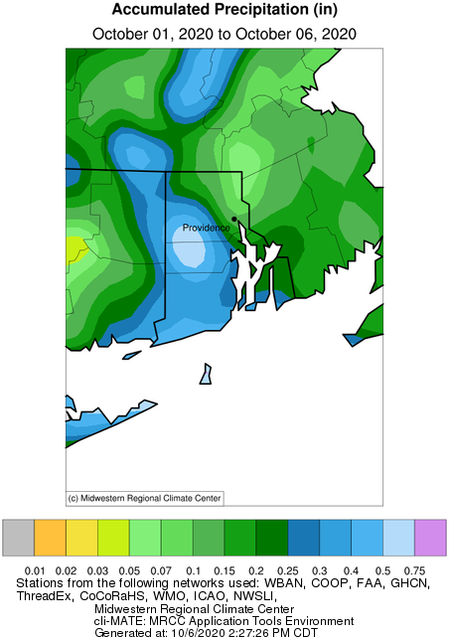
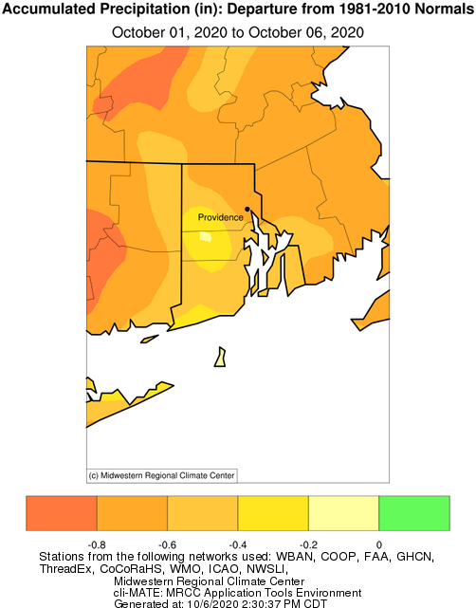
October 1-6 Month-to-date

Slide 10
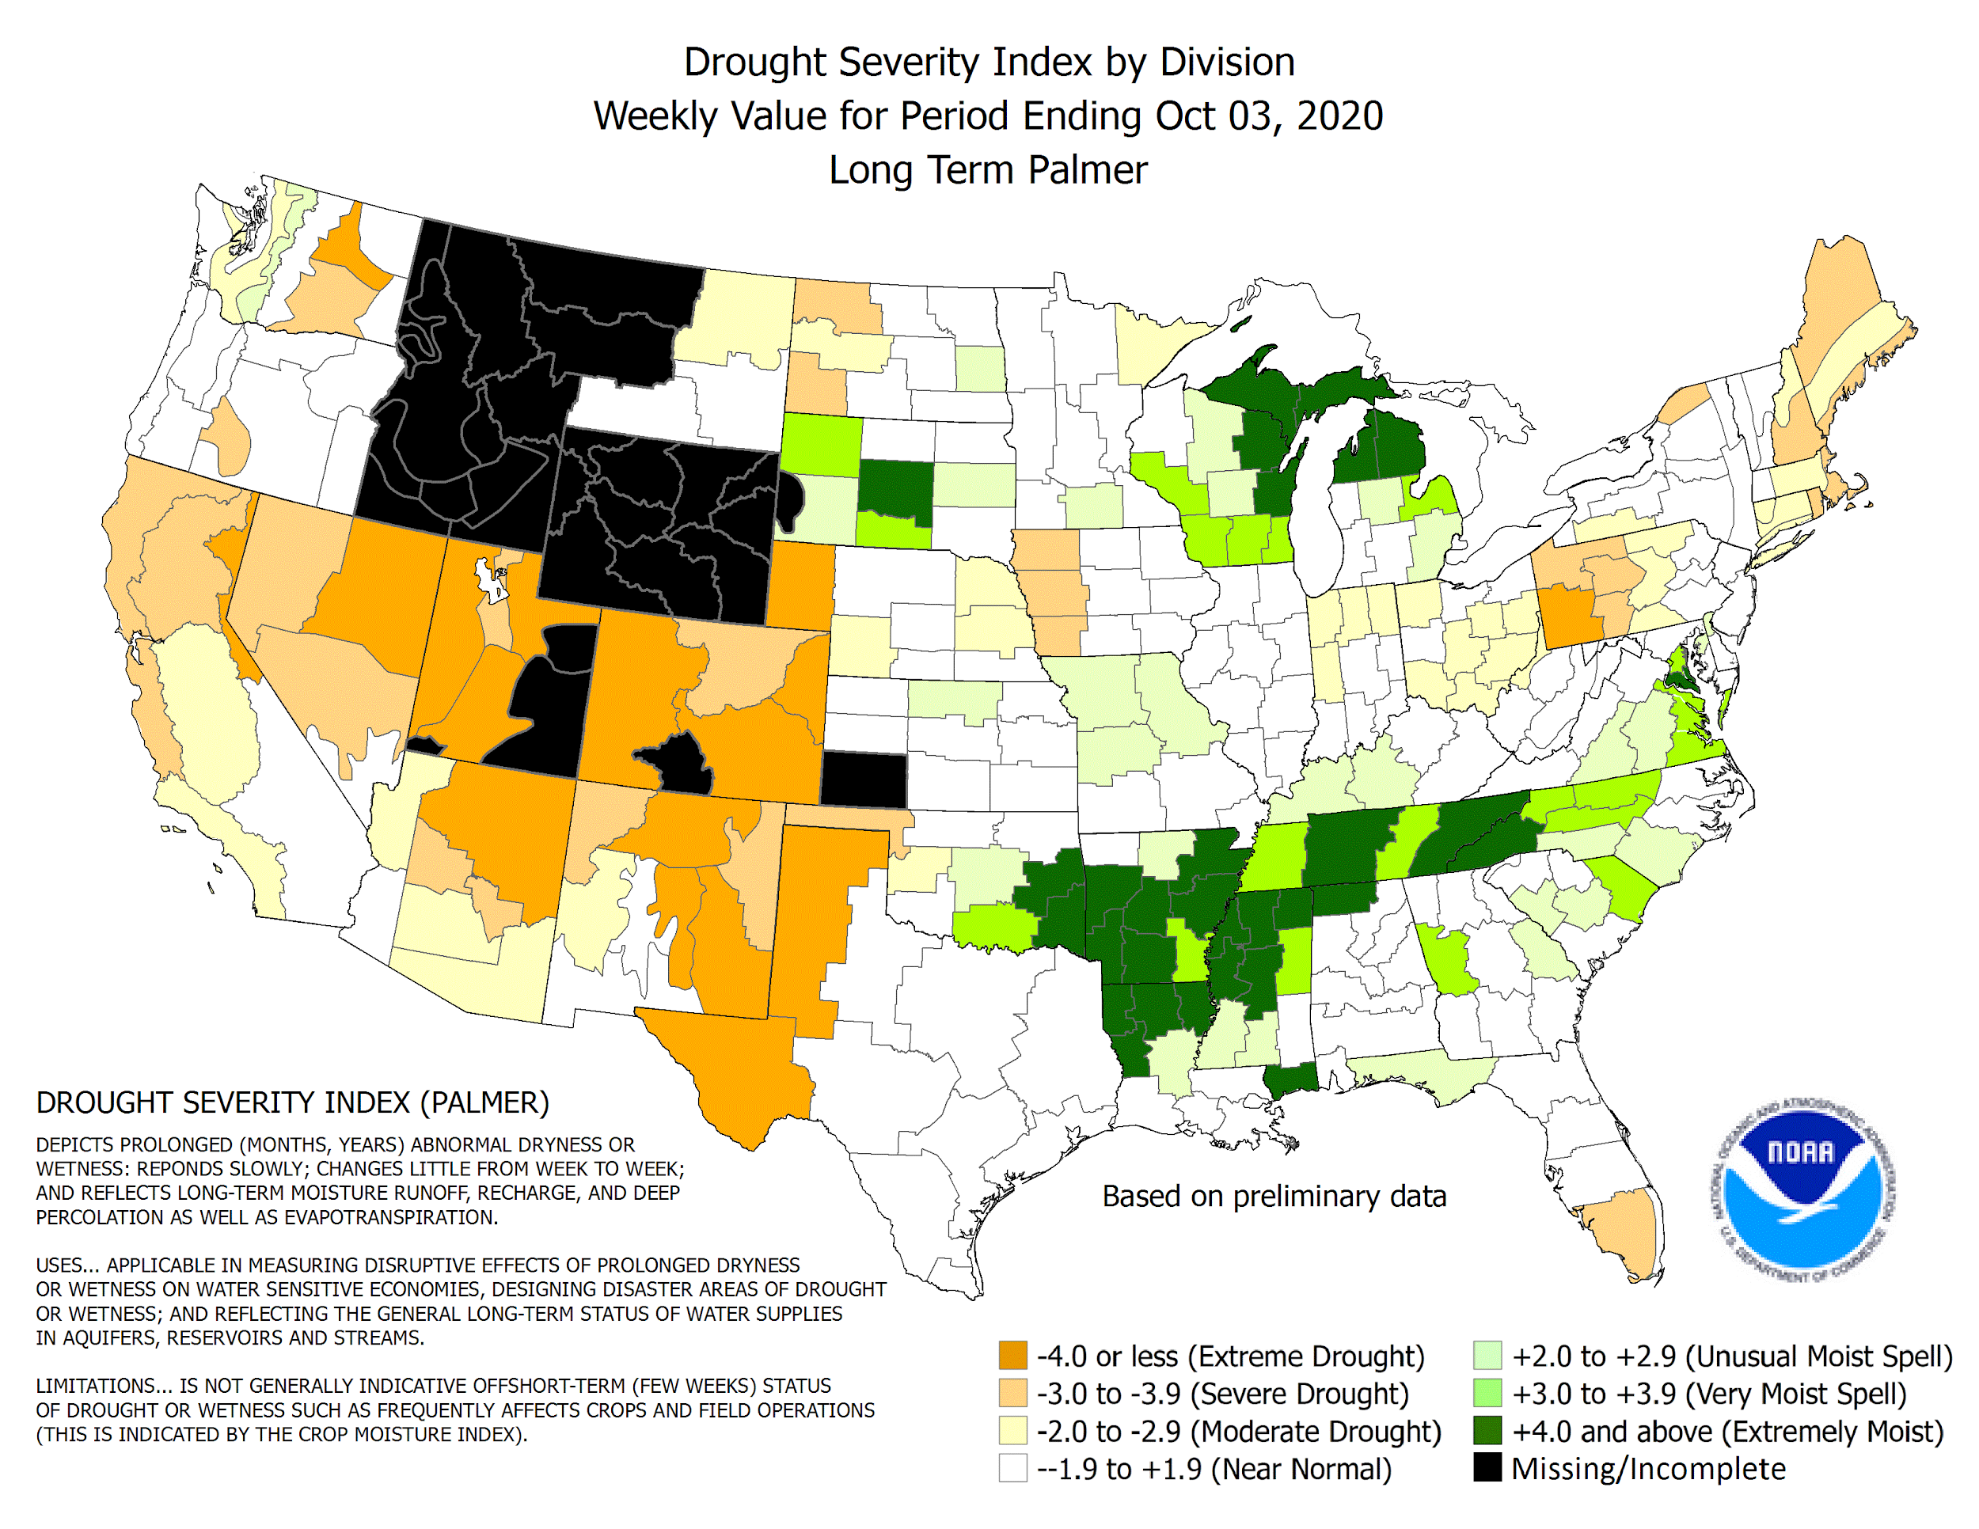
Palmer Drought Index
PDSI for RI: -3.43
Severe Drought
Corresponding Drought Phase for this Index:
Drought Watch

Slide 11
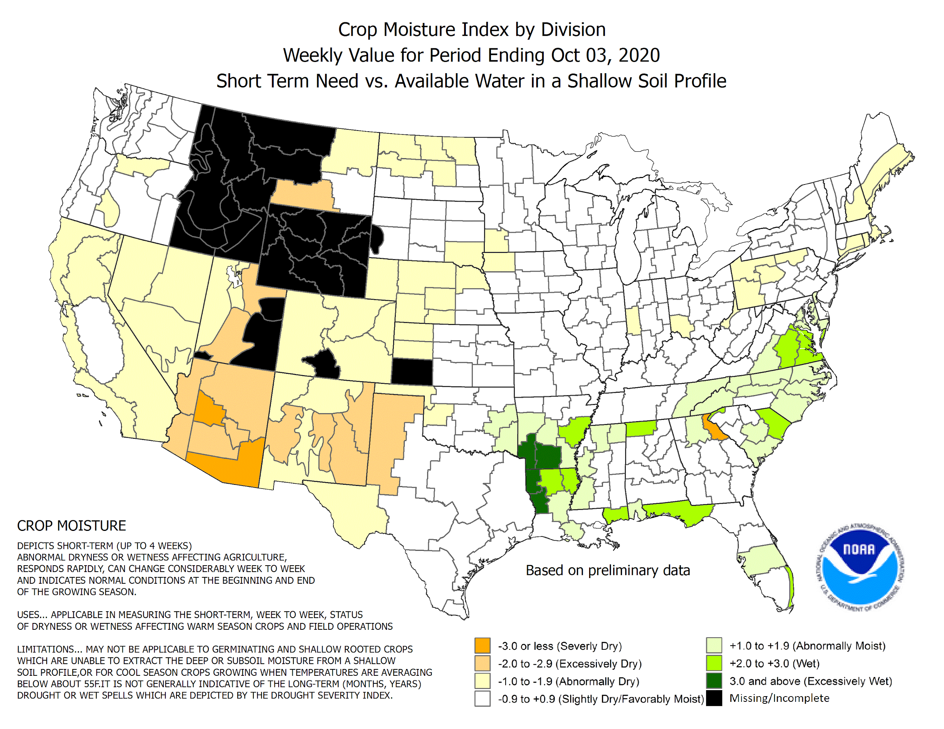
Crop Moisture Index
CMI for RI: -1.81
Abnormally Dry
Corresponding Drought Phase for this Index:
Drought Advisory

Slide 12
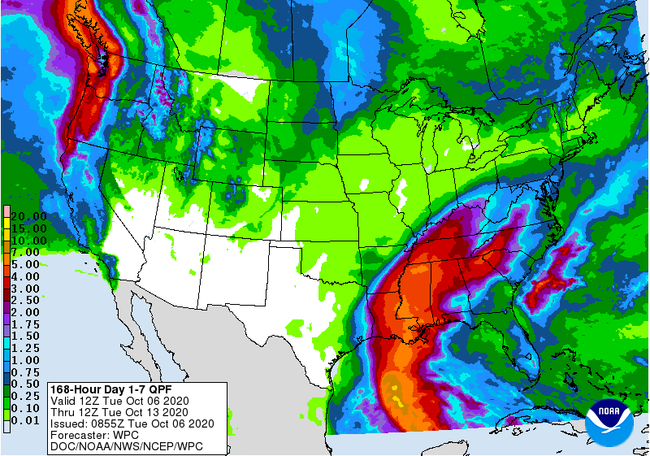
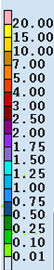
Rainfall Forecast through 8 am Tuesday 10/13

Slide 13
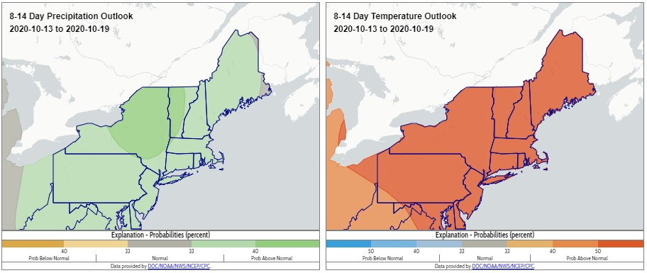
Outlook for Oct 13-19 2020

Slide 14
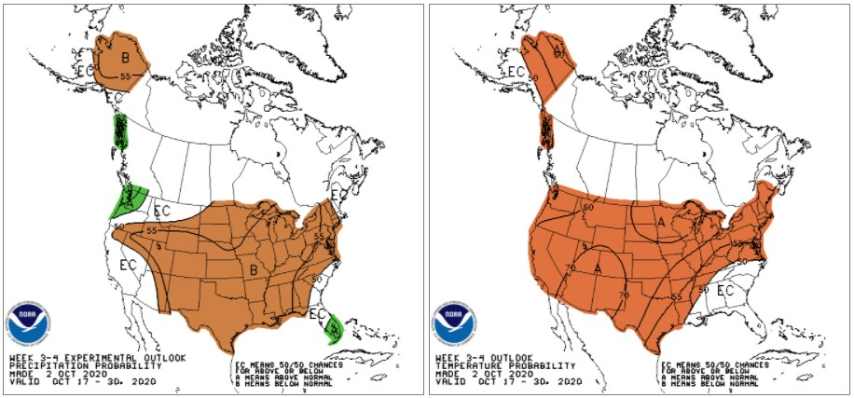
Week 3-4 Outlook*: Oct 17-30
*Outlook updated at 3 pm EDT Friday

Slide 15
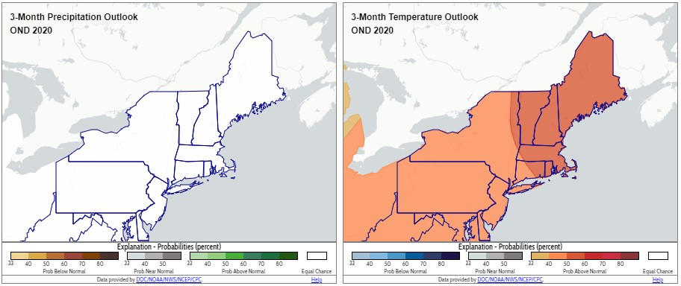
3 Month Outlook- Oct/Nov/Dec

