Slide 1
RI Drought Steering Committee Meeting
NWS Update
National Weather Service Boston/Norton MA
February 9 2021

Slide 2
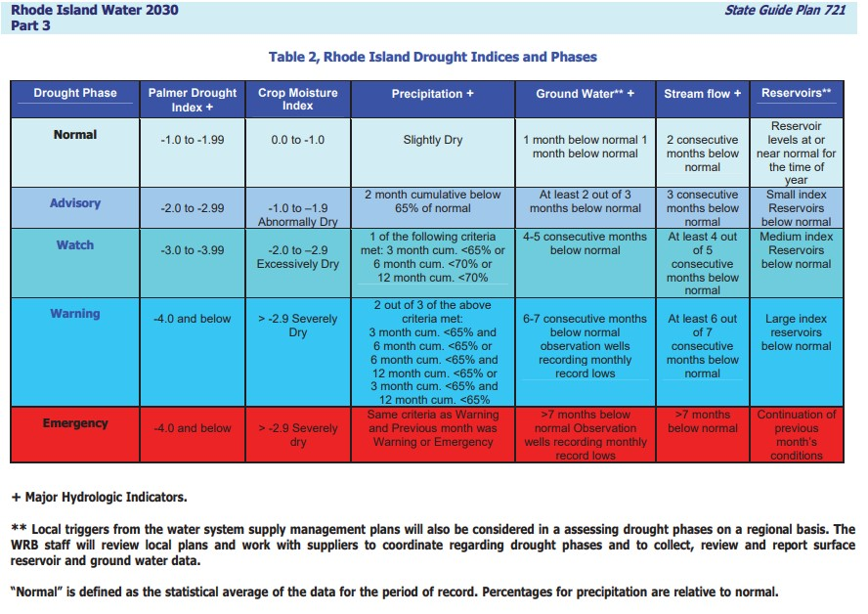
Drought Indices From Rhode Island Water 2030 Document
Notes:
This NWS presentation will provide details for the following Drought Indices: Precipitation, Palmer Drought Index, and Crop Moisture Index.

Slide 3
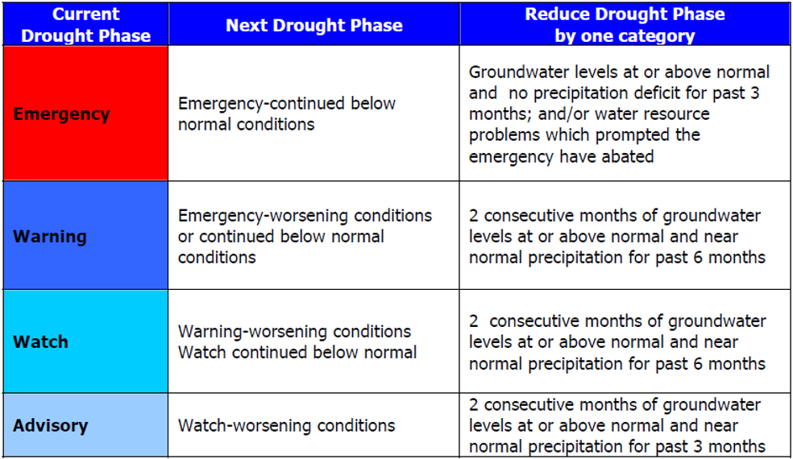
Drought Phase Reduction-Rhode Island Water 2030 Document
Notes:
This NWS presentation will provide details for the following Drought Indices: Precipitation, Palmer Drought Index, and Crop Moisture Index.

Slide 4
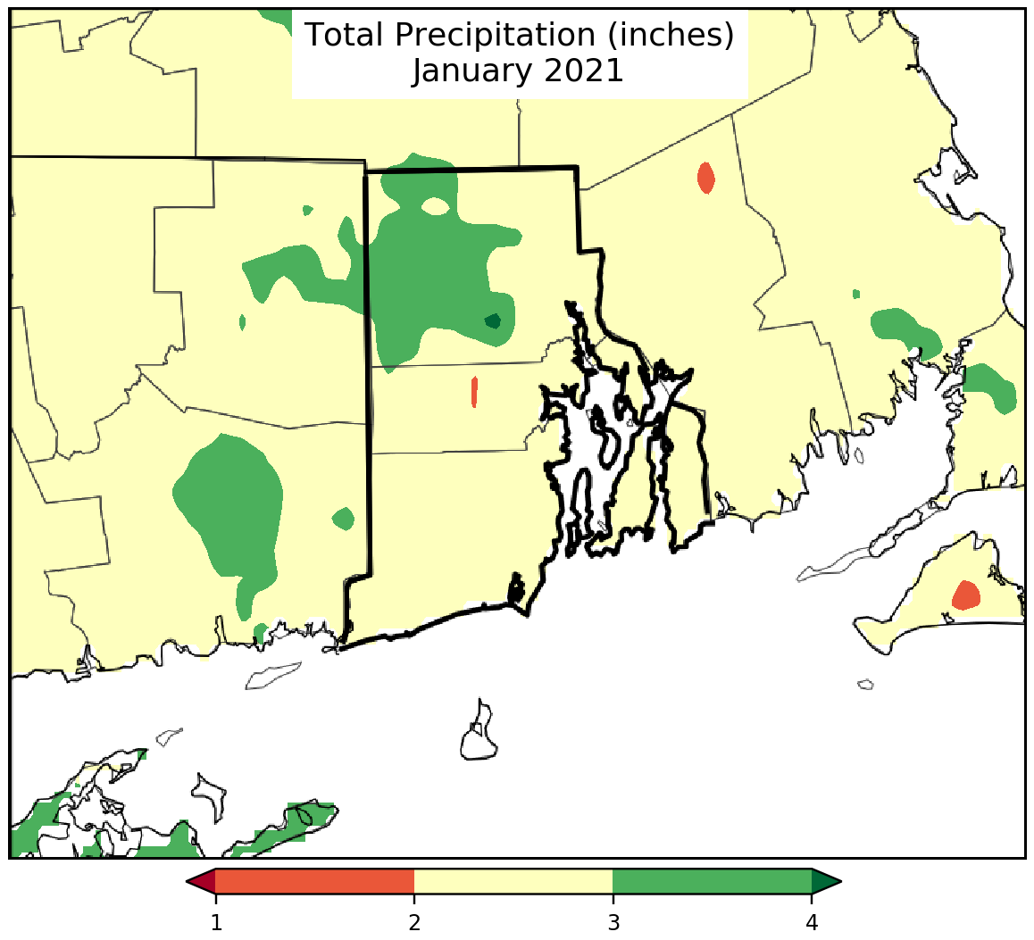
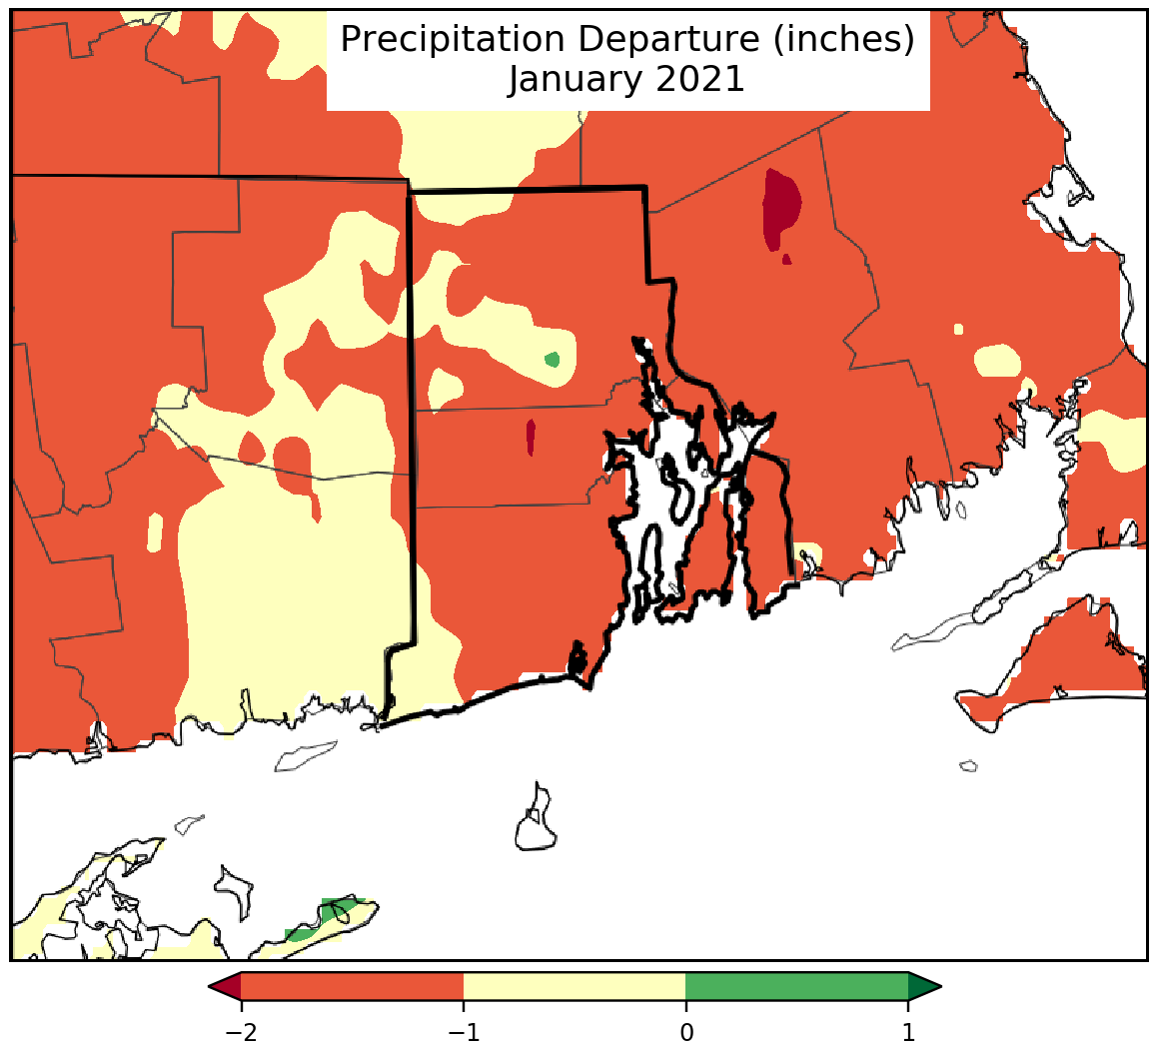
January Precipitation and Departure
Notes:
Use CLI-MATE for period of October 1-present and July 1 to present percent of normal rainfall.

Slide 5
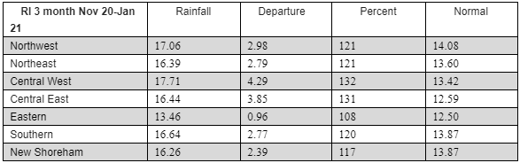
3-Month Precipitation Nov ‘20-Jan ‘21

Slide 6
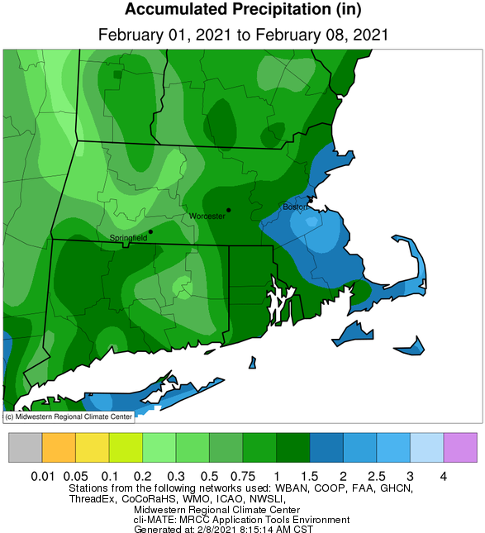
Feb 1-8, 2021 Precipitation
Notes:
Use Cli-MATE for October MTD precip and depature from normal.

Slide 7
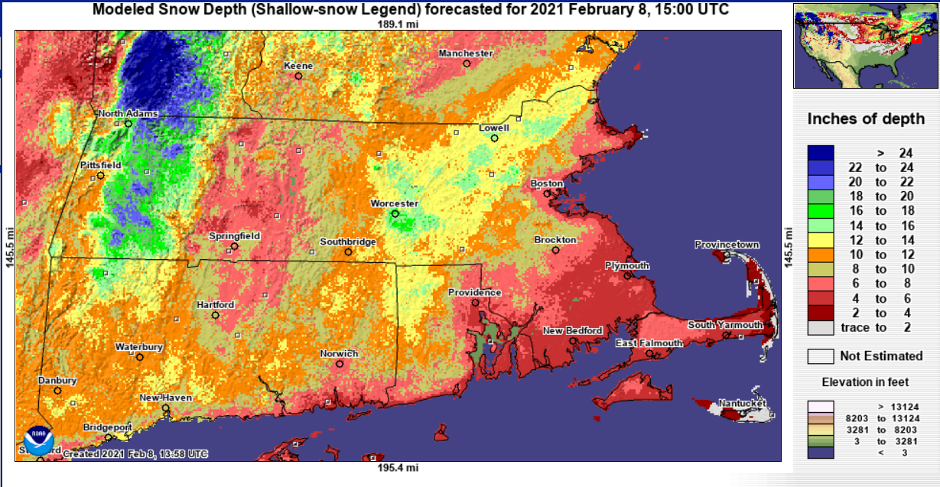
NWS NOHRSC Snow Pack (Modeled)
Notes:
Use Cli-MATE for October MTD precip and depature from normal.

Slide 8
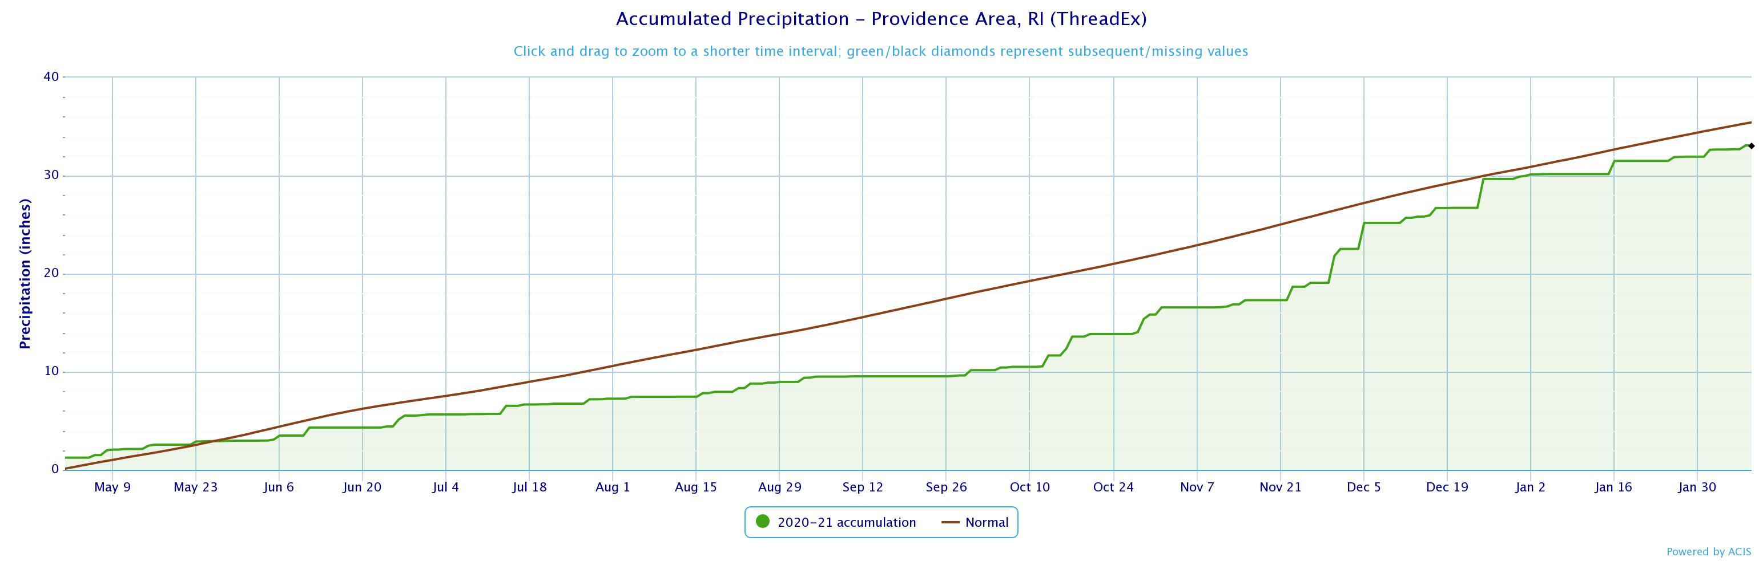
Precipitation for Providence/TF Green from May 1 2020 to Feb 7 2021
Deficit as of Feb 7: 2.35”
Normal cumulative precipitation
Actual
precipitation
Notes:
TF Green/PVD precip time series going back to Jan 1. From xmacis.

Slide 9
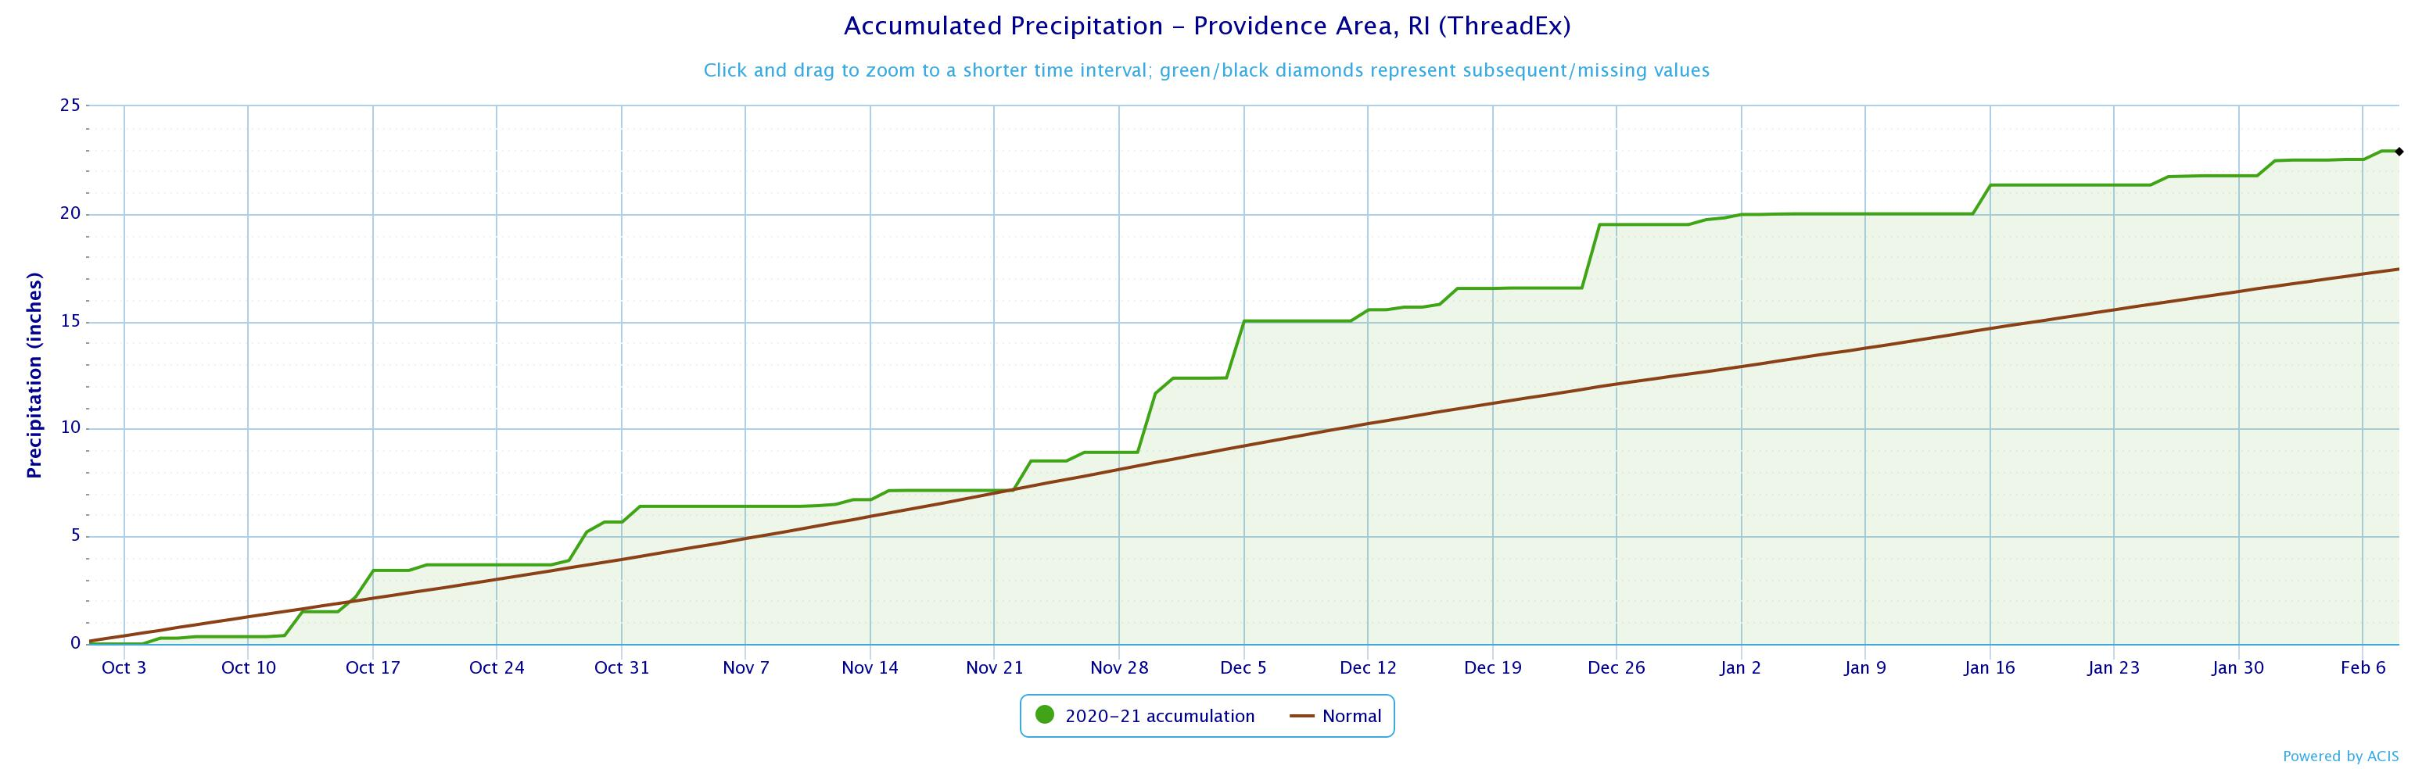
Providence/TF Green Precipitation for
current Water Year
Surplus as of Feb 7: 5.25”
Actual
precipitation
Normal cumulative precipitation
Notes:
Woonsocket Coop precip time series going back to Jan 1. From xmacis.

Slide 10
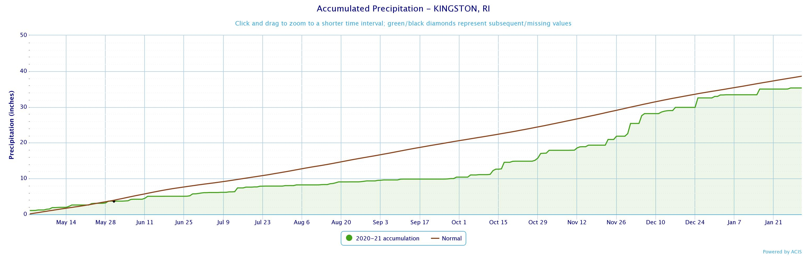
Precipitation for Kingston from May 1 2020 to Jan 31 2021
Deficit as of Jan 31: 3.29”
Normal cumulative precipitation
Actual
precipitation
Notes:
TF Green/PVD precip time series going back to Jan 1. From xmacis.

Slide 11
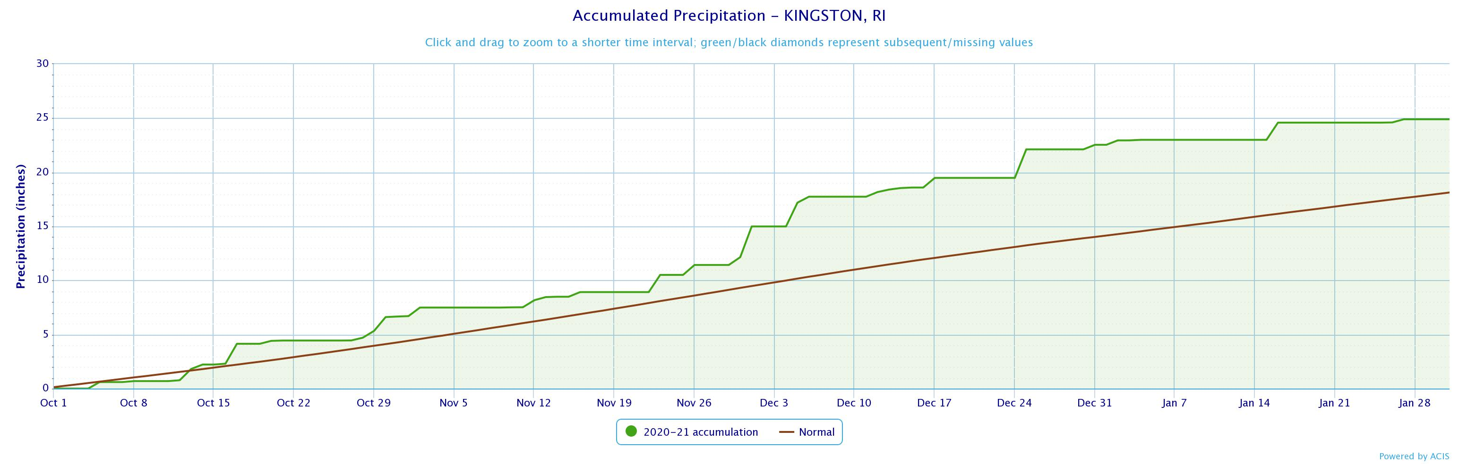
Kingston Precipitation for
current Water Year
Through Jan 31 2021
Surplus as of Jan 31: 6.77”
Actual
precipitation
Normal cumulative precipitation
Notes:
Woonsocket Coop precip time series going back to Jan 1. From xmacis.

Slide 12
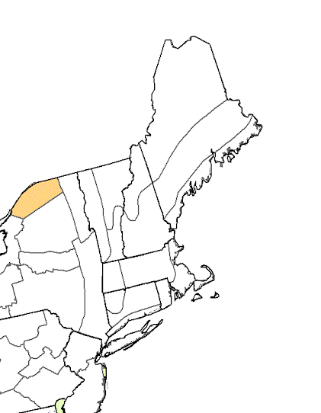
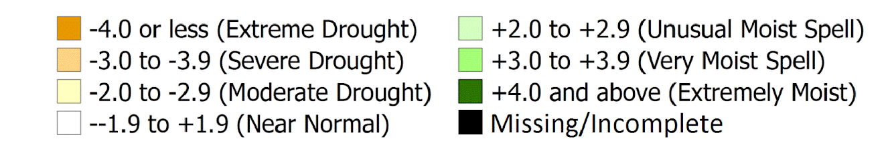
Palmer Drought Index (1/30/21)
PDSI for RI: +1.36 (Prelim)
Near Normal
Corresponding Drought Phase for this Index:
Normal

Slide 13
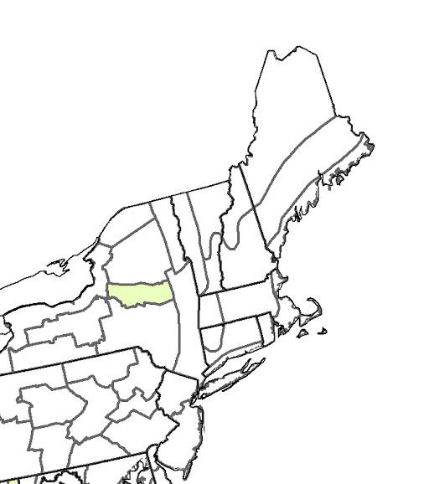
Crop Moisture Index (1/30/21)
PDSI for RI: +0.85
Favorably Moist
Corresponding Drought Phase for this Index:
Normal

Slide 14
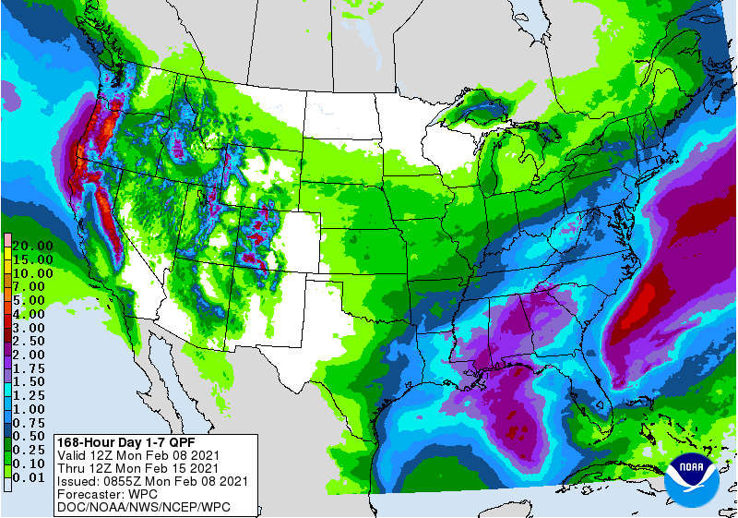
Forecast Tuesday Through Sunday Night…
-Highs in the mid 20s-mid 30s
-Lows 10-20 degrees F
-Repeat chances for snowfall

Slide 15
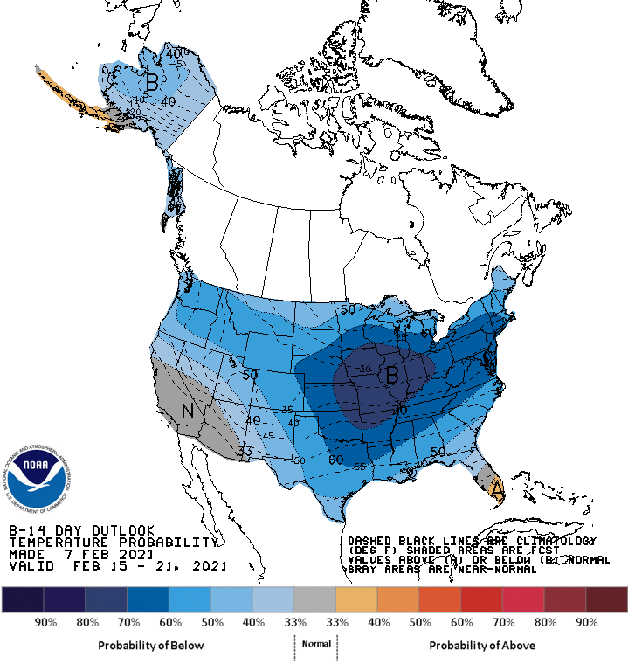
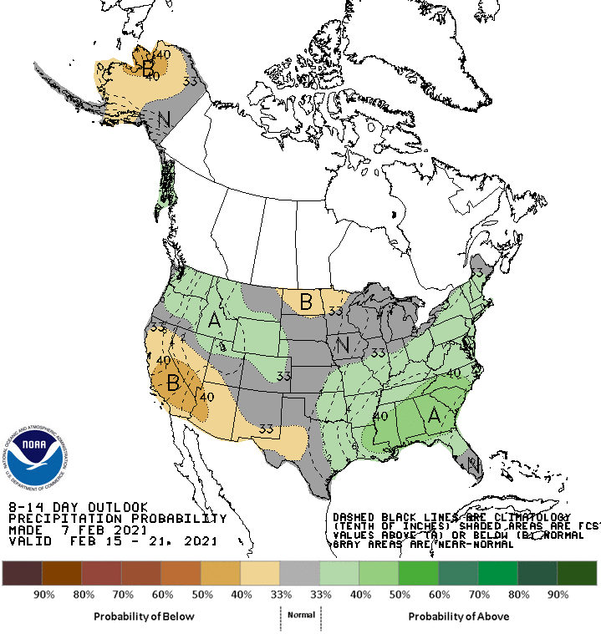
Climate Prediction Center Forecast: Feb 15-21

Slide 16
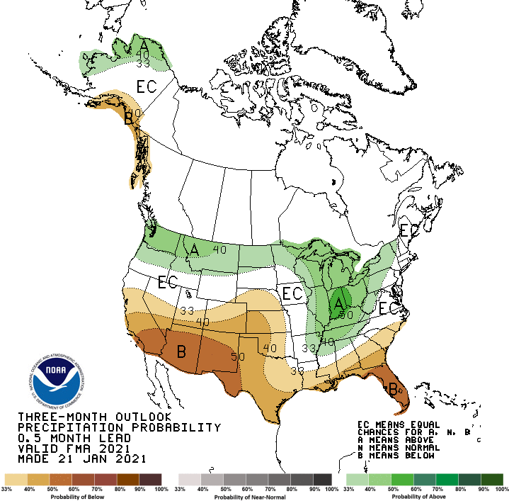
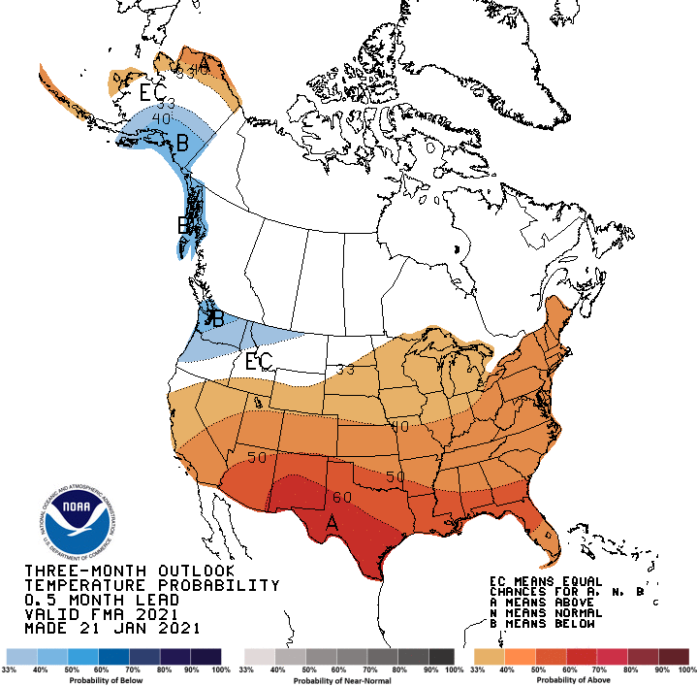
Outlook for Feb/Mar/Apr

